Slide 1
5/19
Today we start the last topic of the year!
Woohoo!

Slide 2
Skip Ahead to
Page 279
5/19
Aim:
Geologic History
of New York:
ESRT pages 8 and 9

Slide 3
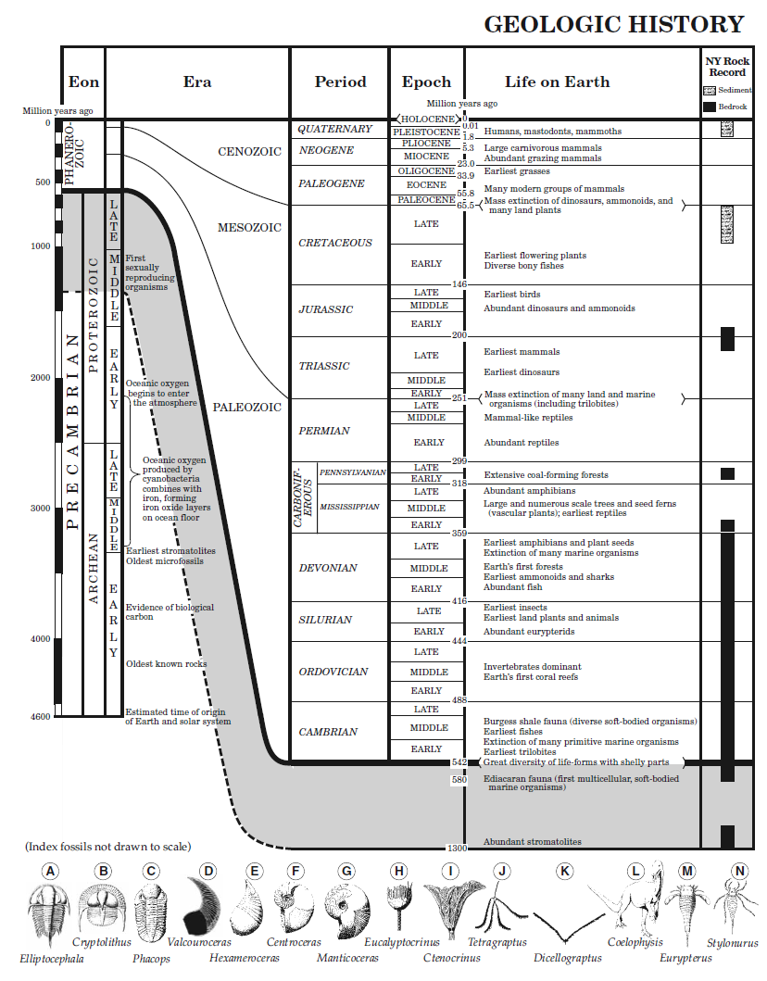
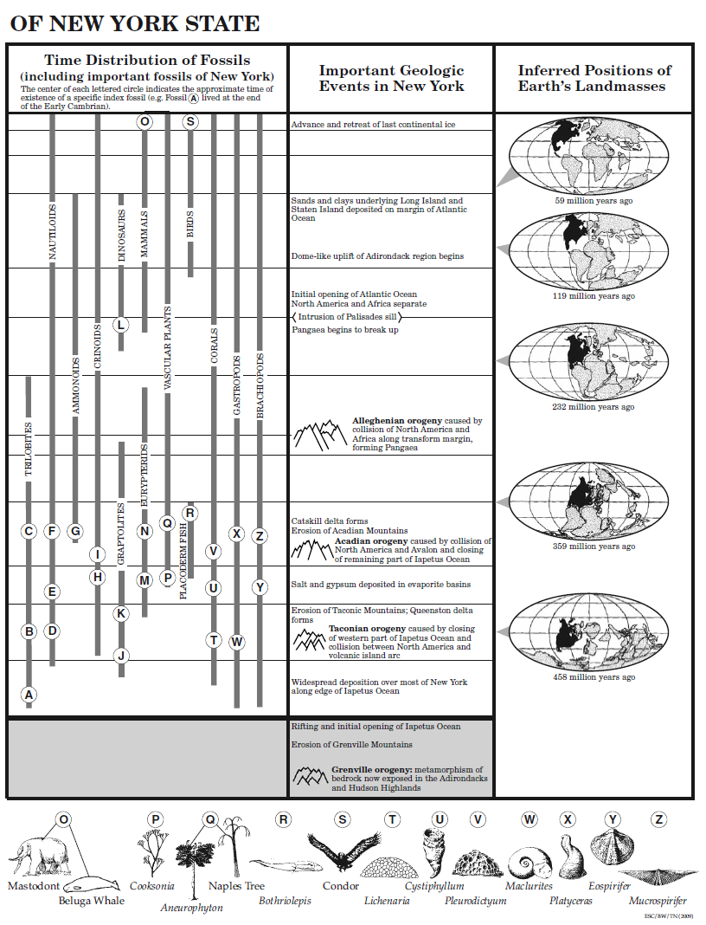

Slide 4
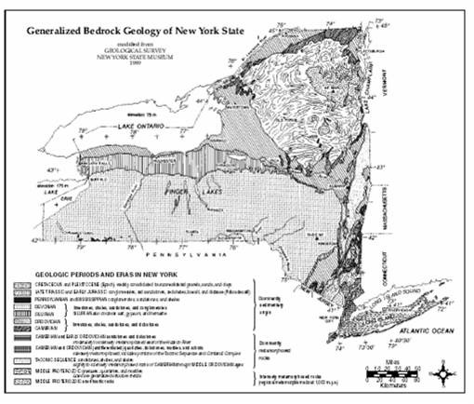

Slide 5
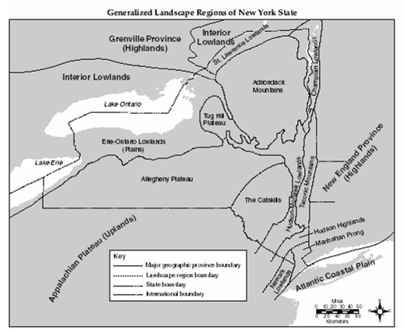

Slide 7
1.
Geologic Time Scales are read from the
bottom (oldest) to
the top (youngest)

Slide 10
2.
The Earth is approximately 4600 million years old
(4.6 billion years old)

Slide 12
3.
The Precambrian Eon represents most of Earth’s history, but it is rare to find fossils of that time because organisms that existed during that time did not have hard body parts that could fossilize.

Slide 14
4.
The geologic time scale
is based mainly upon fossil evidence.

Slide 16
5.
Most organisms over time have become extinct.
Mass extinctions are thought to be caused by meteorite impacts and/or global climate change

Slide 20
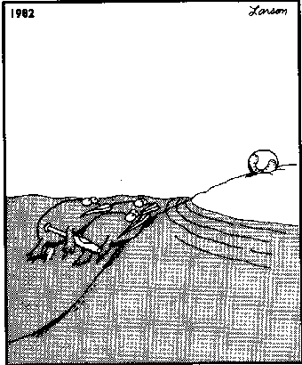
10.

Slide 21
6.
The fossil record supports the theory of evolution.
An increase in complexity of organisms can be seen in the fossil record.

Slide 23
7.
The Earth’s atmosphere changed from having no oxygen to an abundance of oxygen as a result of CO₂ gas being released from Earth’s interior
(out-gassing from volcanic activity). The CO₂ was later converted to O₂
by plant photosynthesis.

Slide 25
8.
Index fossils are remains of organisms that lived for a relatively short period of time
but found over a large geographic area.

Slide 27
9.
Many of the fossils found in New York State suggest that parts of New York were once a shallow marine environment.

Slide 29
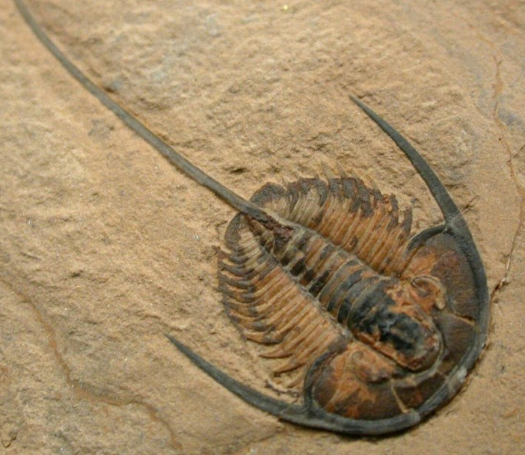
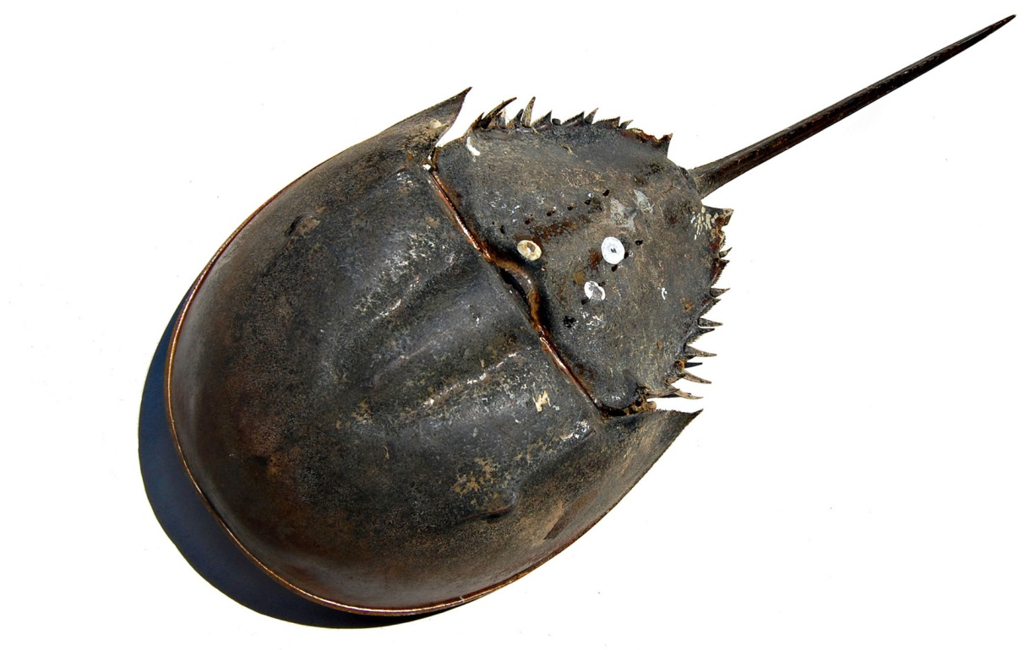

Slide 30
10.
There is no rock record in
New York for the Permian, Paleogene, or Neogene Periods.

Slide 31
x
x

Slide 32
x
x

Slide 33
11.
An orogeny is a major
mountain building event

Slide 34
x
x

Slide 35
Using the Geologic History Chart with the NYS Maps

Slide 40
5/19
Please open to yesterday’s classwork

Slide 41
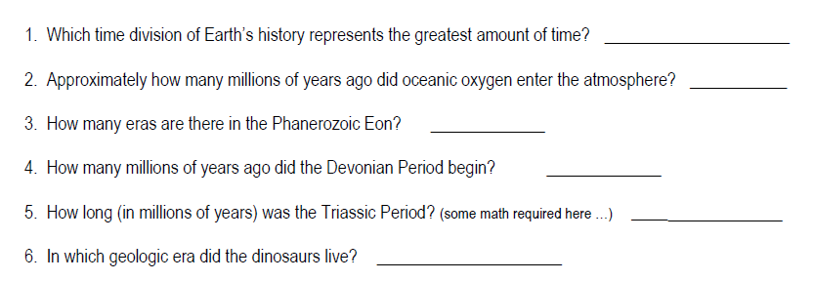

Slide 42
x
x

Slide 43
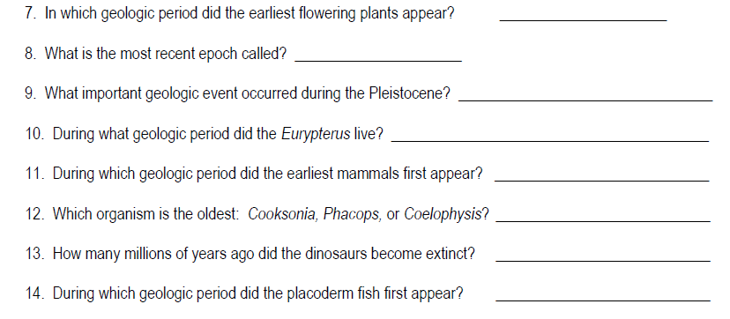
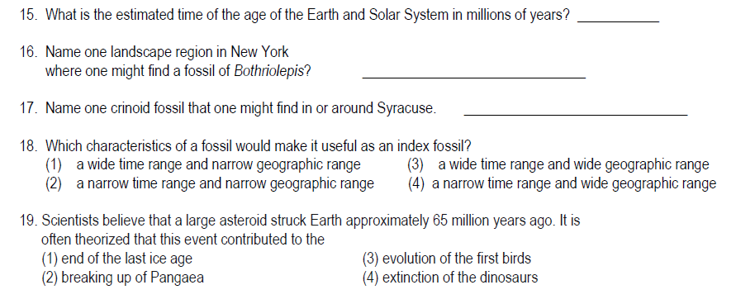

Slide 44
x
x

Slide 46
x
x

Slide 47
x
x

Slide 48
5/22
Short Week!!
(and almost done …)
Please turn to page 280 and
ESRT pages 8-9
for a quick review and then back
to candy competition 2!

Slide 49
Which time division represents the greatest amount of time?
x
PRECAMBRIAN EON
x

Slide 50
x
PRECAMBRIAN EON
x
1. Which time division represents the
greatest amount of time?

Slide 51
x
2000 million years
x
2. How many millions of years ago did
oceanic oxygen enter the atmosphere?

Slide 52
x
3
x
3. How many eras are there in the
Phanerozoic Eon?

Slide 53
x
x
416 m.y.a.
4. How many millions of years ago did the
Devonian Period Begin?

Slide 54
x
51 million years
x
5. How long (in millions of years) was the
Triassic Period?)

Slide 55
x
x
Mesozoic Era
6. In which geologic era did dinosaurs live?

Slide 56
x
Cretaceous Period
x
7. In which geologic period did the earliest
flowering plants appear?

Slide 57
Holocene Epoch
x
x
8. What is the most recent epoch called?

Slide 58
x
Advance and retreat of last continental ice (last ice age)
x
9. What important geologic event occurred
during the Pleistocene?

Slide 59
x
10. During what geologic period did
Eurypterus live?
x
Silurian Period

Slide 60
Using the Geologic History Chart with the NYS Maps

Slide 65
x
11. During which geologic period did the
earliest mammals first appear?
x
Triassic

Slide 66
x
12. Which organism is the oldest:
Cooksonia, Phacops, or Coelophysis?
x
Cooksonia

Slide 67
x
65.5 million years ago
x
13. How many millions of years ago did the
dinosaurs become extinct?

Slide 68
x
14. During which geologic period did the
placoderm fish appear?
x
Silurian Period

Slide 69
15. What is the estimated time of the age
of the Earth and Solar System in
millions of years?
x
x
4600 million years

Slide 70
16. Name one landscape region in
New York where one might find a
fossil of Bothriolepis?
x
x
…lived during the Devonian Period

Slide 71
find the Devonian symbol …

Slide 72
…match up to a landscape region

Slide 73
17. Name one crinoid fossil that one might
find around Syracuse?
Syracuse has Silurian bedrock

Slide 74
17. Name one crinoid fossil that one might
find around Syracuse?
x
find crinoids
x
find correct index letter
Eucalyptocrinus

Slide 77
Happy Tuesday that 5/23 feels like a Thursday
(only 4 more AIMs left!)
Let’s complete the last candy challenge
page 281
Show me when you are done and then work on yellow packet
Make sure to have first Regents Review assignment completed by TOMORROW

Slide 78
x
x

Slide 79
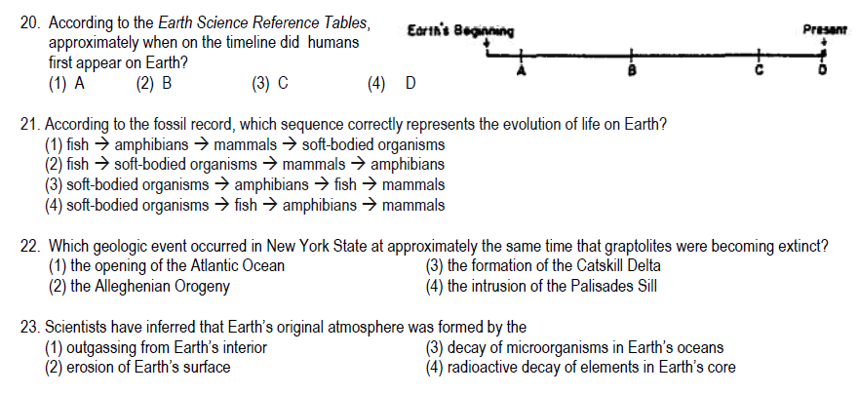

Slide 80
x
x

Slide 81
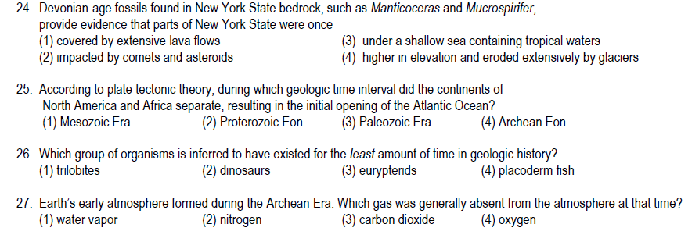

Slide 82
x
x

Slide 83
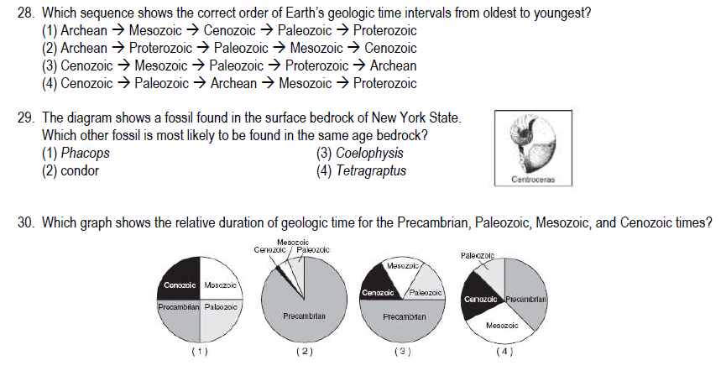

Slide 84
How can the relative age of geologic events be determined?
Aim:
Pages 282-285
5/23

Slide 85
RELATIVE AGE DATING
Putting rock layers and geologic events in order from oldest to youngest.

Slide 86
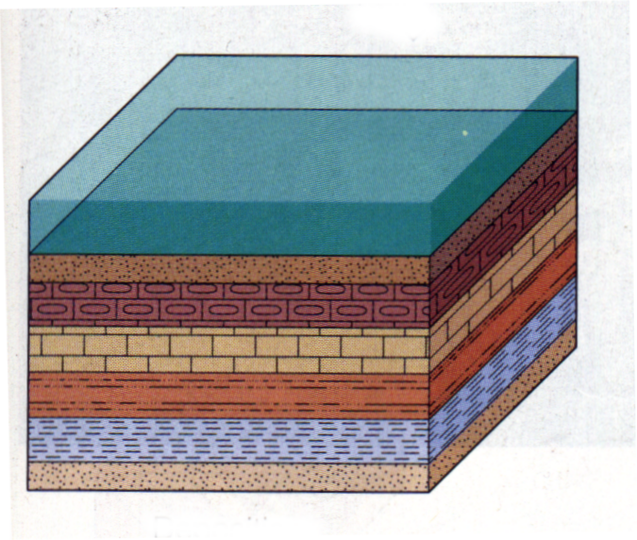
layers of sediment are originally deposited horizontally under the action of gravity
PRINCIPLE OF ORIGINAL HORIZONTALITY

Slide 87
The rock layers on the bottom of undisturbed strata are the oldest.
LAW OF SUPERPOSITION
Youngest
Oldest

Slide 88
sea level

Slide 90
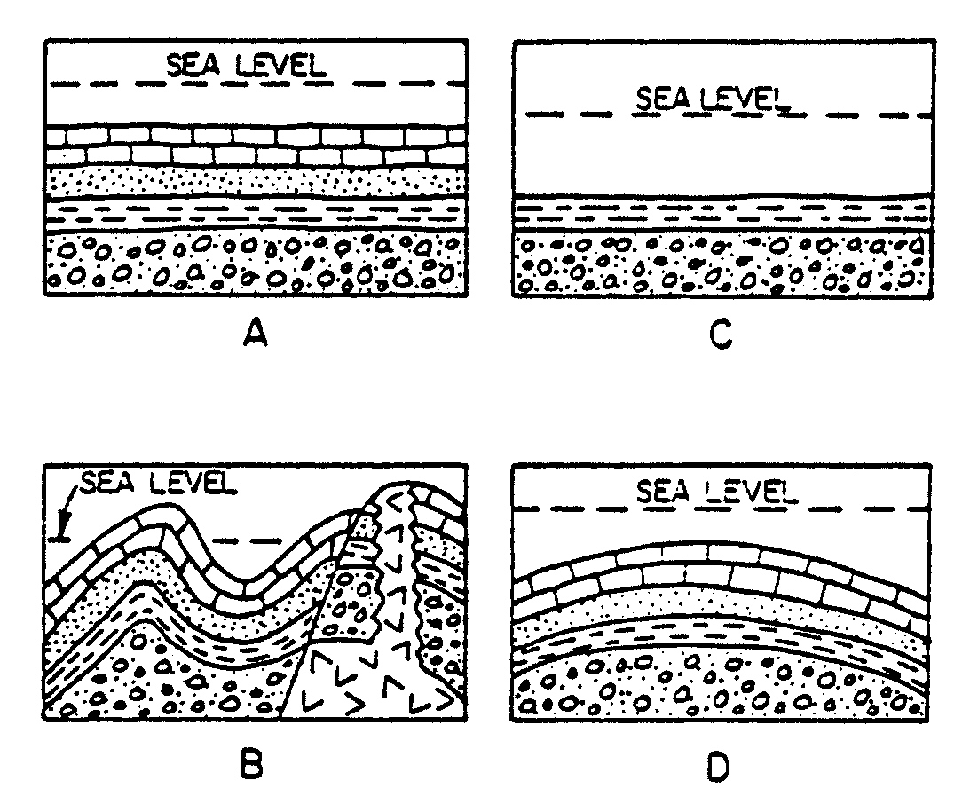
As Easy as it Gets…
4
3
2
1

Slide 91
As Basic as it Gets…
1 – deposition & formation of conglomerate
while submerged
2 – deposition & formation of shale
while submerged
3 – deposition & formation of sandstone
while submerged
4 – deposition and formation of limestone
while submerged

Slide 92
Folding
The bending
of rock strata.

Slide 93
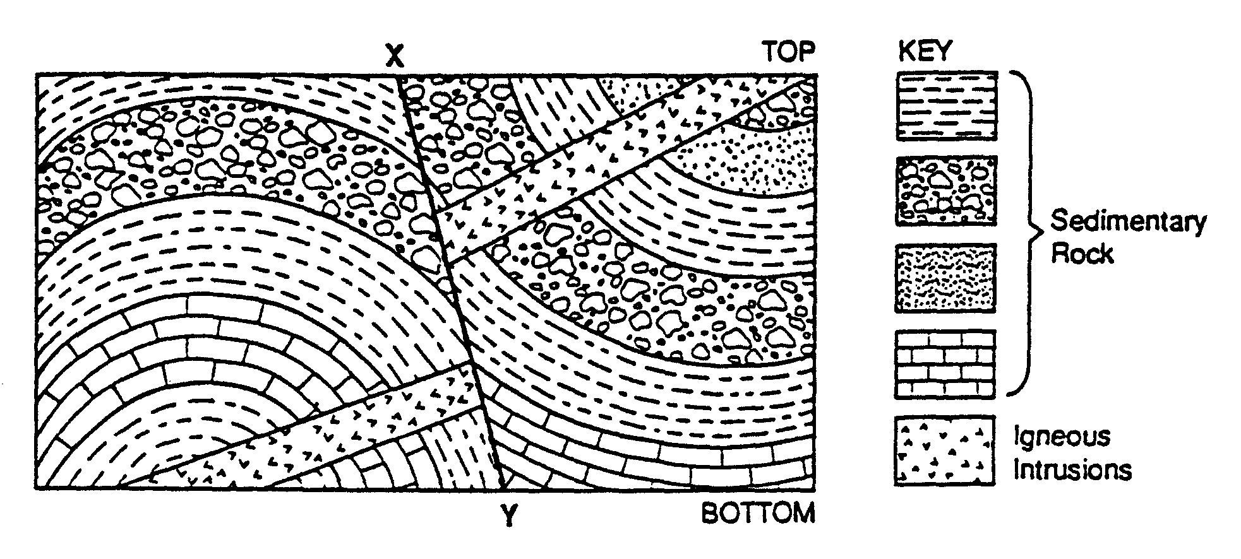

Slide 94
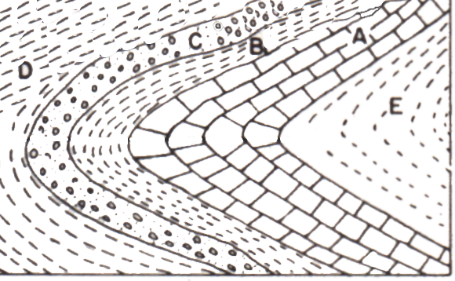

Slide 95
extreme folding leads to overturning

Slide 96
5 Folding
4
3
2
1

Slide 97
6 Folding
1
5
2
4
3
2
1
3

Slide 98
x
x

Slide 99
Unconformities
are also known as
buried erosional surfaces
Unconformities indicate
missing rock layers –
“time gaps” in the rock record

Slide 100
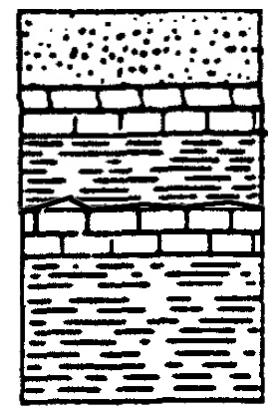


this is what is observed presently...
this is how it formed ...
unconformity

Slide 101
uplift, erosion, submergence, more deposition
unconformity

Slide 102
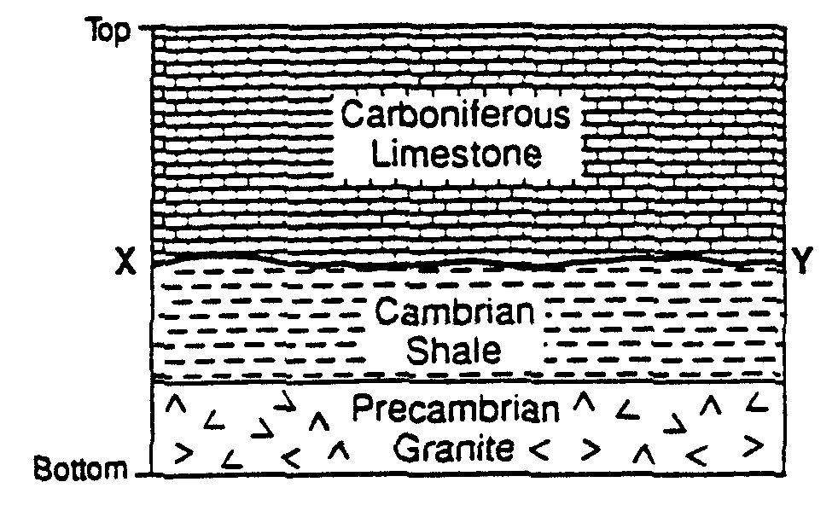
4
3
Uplift/Erosion
(unconformity)
2
1

Slide 103
x
x

Slide 104
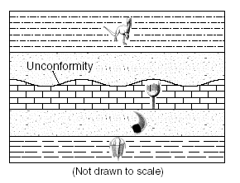

Slide 105
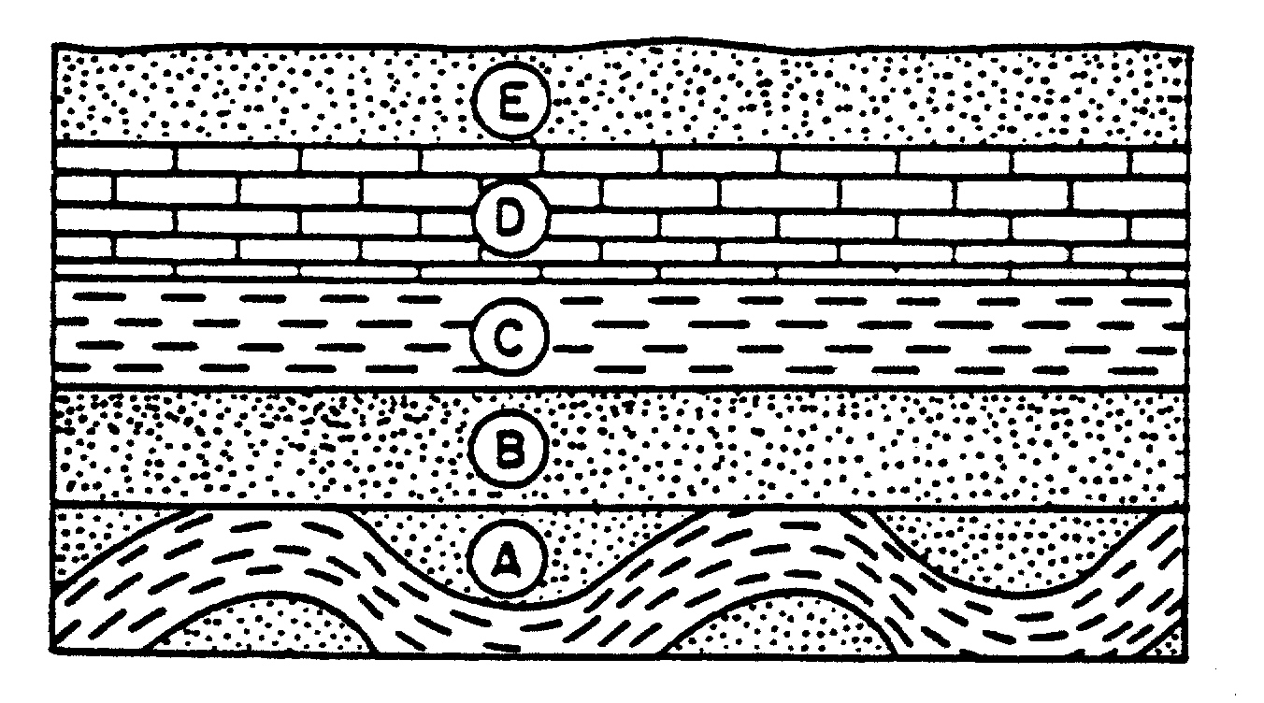
7
5
Uplift/Erosion
(unconformity)
6
2
3
4
Folding
1

Slide 106
8
7
6
Unconformity
(uplift/erosion)
4
3
2
5 Folding
1

Slide 107
FAULTING
Faults are cracks in rock strata along which there is movement
Faults are always younger than rocks they cut through.

Slide 108
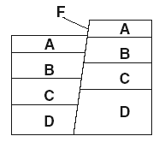
4
5
Faulting
3
2
1

Slide 109
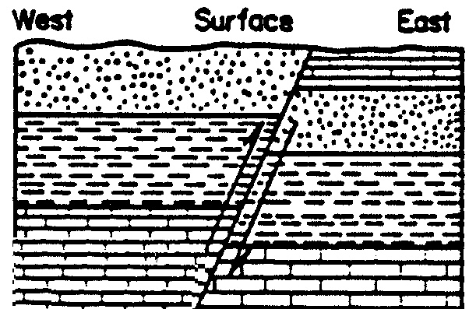
6 Erosion
4
3
5
Faulting
2
1

Slide 110
Igneous Intrusions
to determine relative age, use evidence of
contact metamorphism

Slide 111
Igneous Intrusions
occur when
magma is injected into rock layers already present

Slide 112
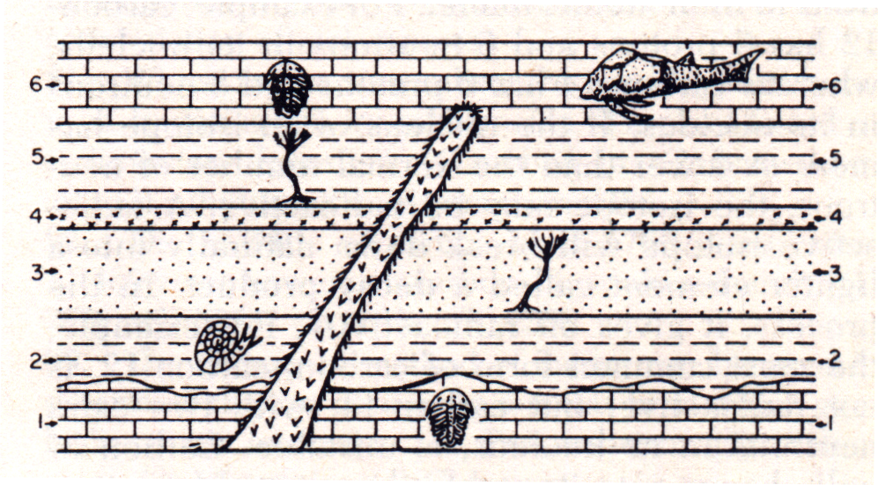
Igneous Intrusions
Magma Intrusion

Slide 116
4
5 Igneous Intrusion
3
2
1

Slide 117
5
4 Igneous Intrusion
3
2
1

Slide 118
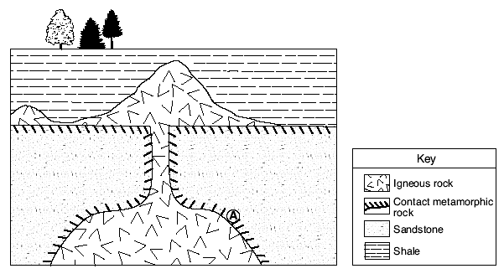

Slide 119
5/30
Do you realize that we only have
10 more school days left???
IMMEDIATELY – LIKE RIGHT NOW -
Open to page 285 ☺

Slide 120
Complete your
Yellow Regents Review Packet
by this Friday!!

Slide 121
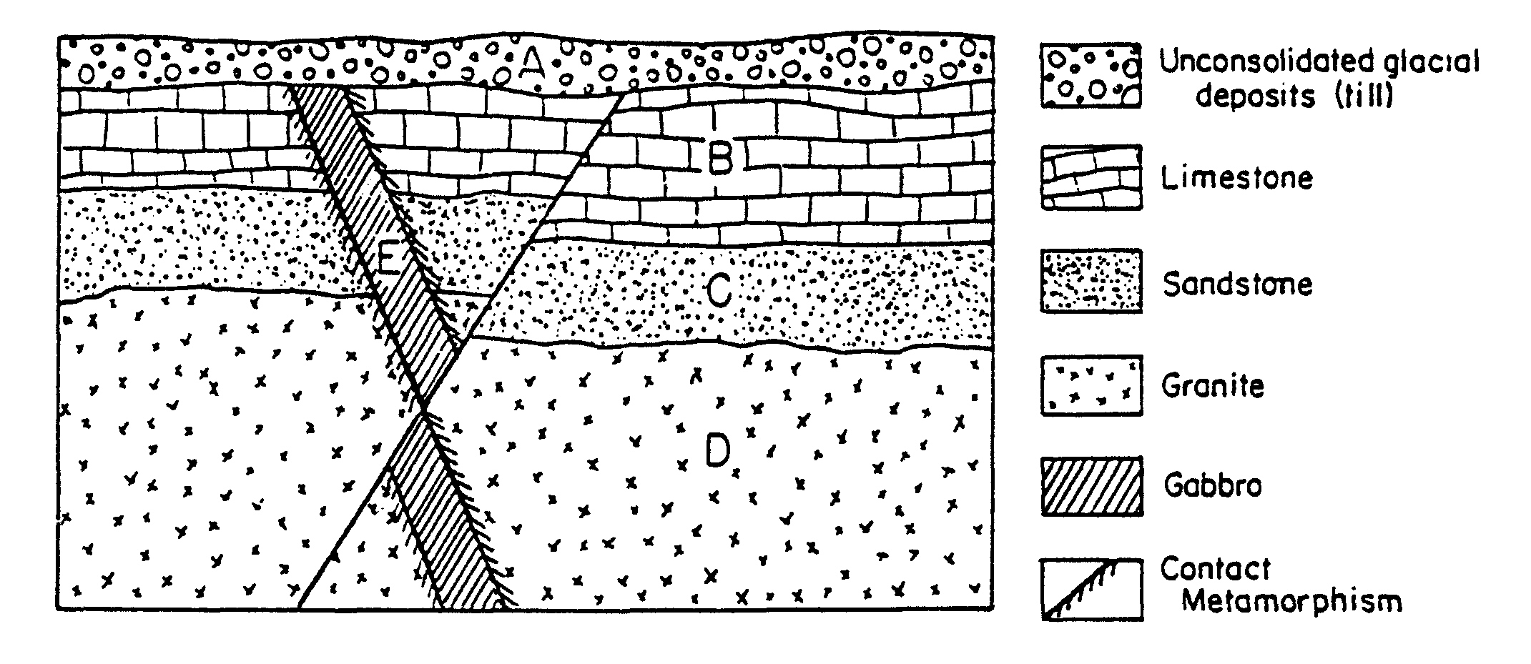
6 Unconformity
(uplift/erosion)
7
3
5
Faulting
2
1
4
Intrusion

Slide 122
How are rock layers correlated?
Page 286
5/30
AIM:

Slide 123
Correlation
The matching of similar rock strata from different locations

Slide 124
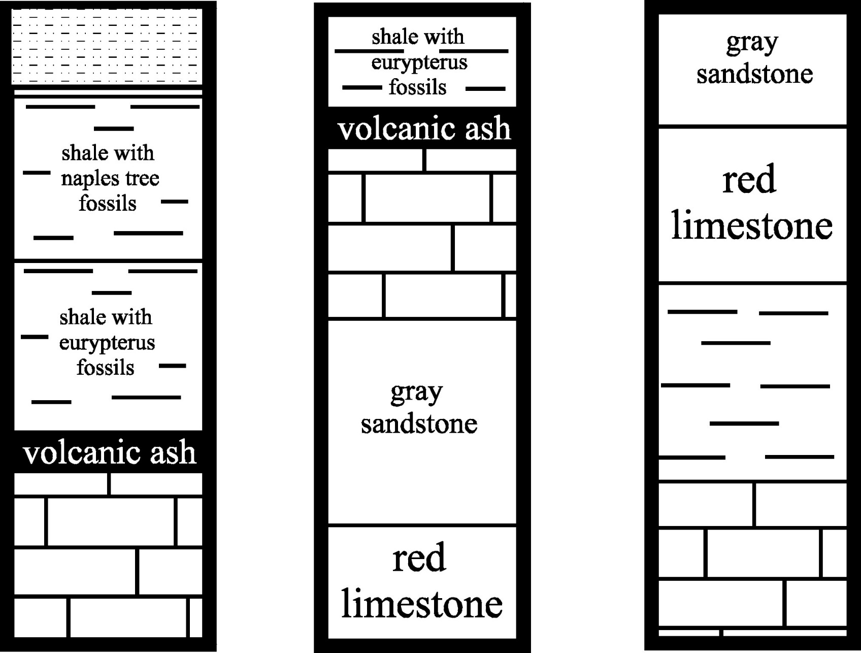
1 2 3

Slide 125
Walking the Outcrop
1
Visually noting similarities in rock types in exposed bedrock.

Slide 126
Geologic Time Markers
2
“Rapid” events that occur over a large area that can easily be matched up.
ex. volcanic ash,
unconformities

Slide 127
Index Fossils
3
**BEST WAY**
A fossil of an organism that
existed for a short period
of time, but found
widespread geographically.
found in one layer (row),
but in all rock outcrops (columns)

Slide 128
x
x

Slide 129
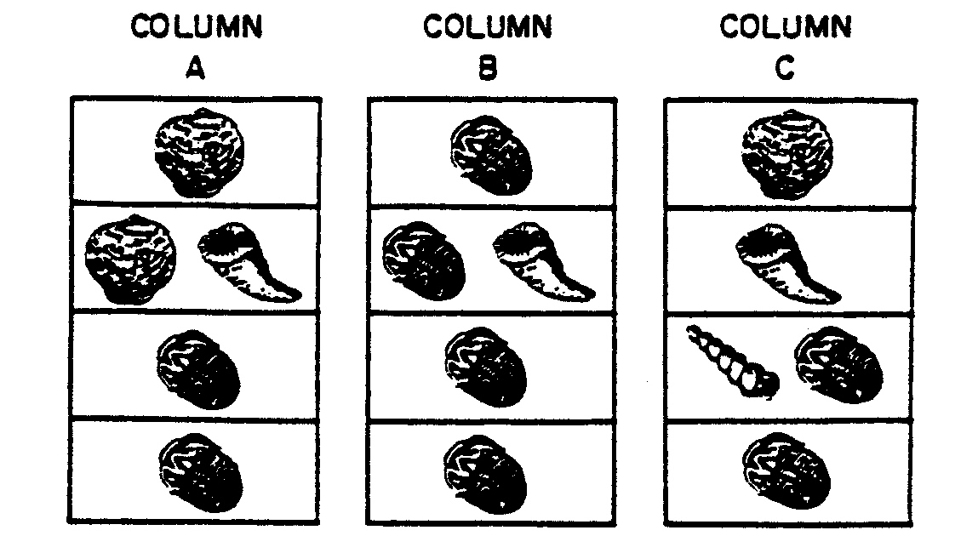
Which letter represents the best index fossil?

Slide 130
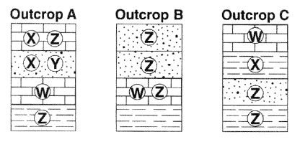
Which letter represents the best index fossil?

Slide 131
1 2 3

Slide 132
1 2 3

Slide 133
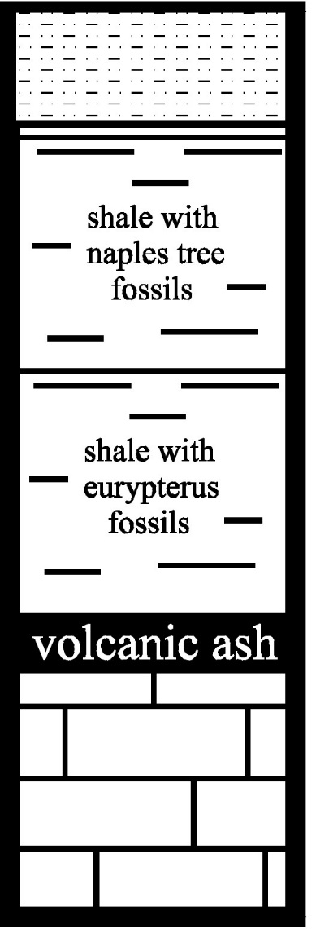


Slide 135
1 2 3

Slide 136



Slide 137




Slide 138
1 2 3

Slide 139
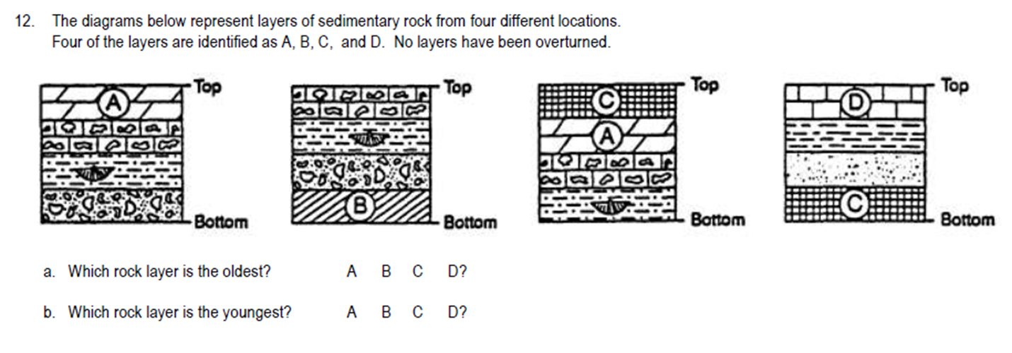

Slide 140
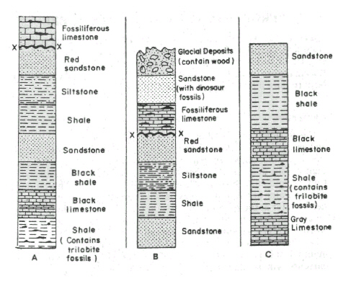

Slide 145
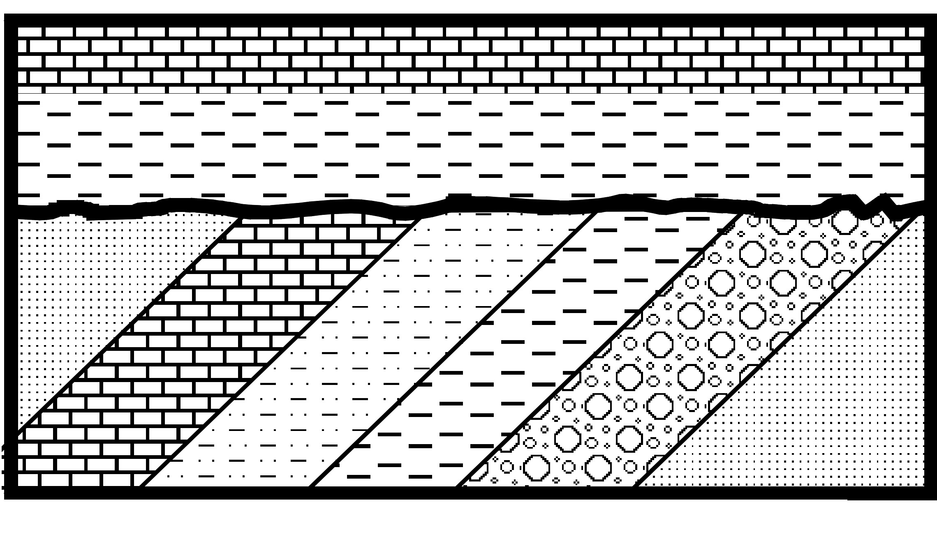
10
9
8
Erosion
6
5
4
3
2
7 Folding or
Tilting
1

Slide 146

8 Erosion
5
4
6
Intrusion
3
2
1
7 Faulting

Slide 147
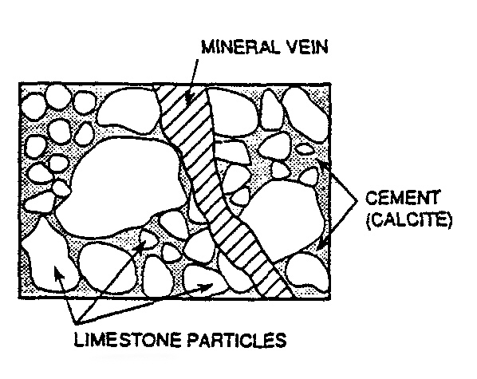
4
3 conglomerate rock
2
1

Slide 148
Happy Friday! 6/2
Job 1: Open to page 275 for the
Second to Last Aim of the Year!!!
Job 2: Continue Regents Review
in Yellow Packet
HW: FIRST PRACTICE REGENTS!!!
Pink Packet Due Monday
Gray Packet Due Tuesday

Slide 149
What factors determine the features of a landscape?
Page 275
6/2
The 2nd to Last AIM!

Slide 150
1.
Underlying
Bedrock
Structure

Slide 151
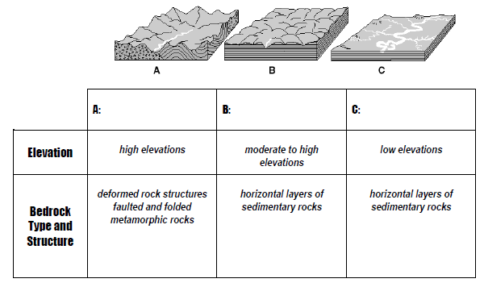
1.
Underlying Bedrock Structure

Slide 153
horizontal bedrock structure
“true” mountains have deformed bedrock

Slide 157
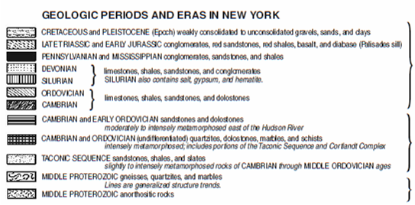

Slide 158
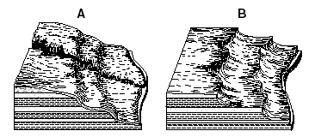
Climate
2.

Slide 159
Climate
2.
Humid Climates
rounded, smooth landforms
HUMID

Slide 160
Climate
2.
Arid (Dry) Climates
jagged
(sharp) landforms
ARID

Slide 161
2.
Climate
HUMID
ARID

Slide 162
Page 278
6/2
Stream Drainage Patterns

Slide 163
Let’s look at the drainage pattern of a house …

Slide 165


Slide 167
a. Dendritic
flatter regions

Slide 168
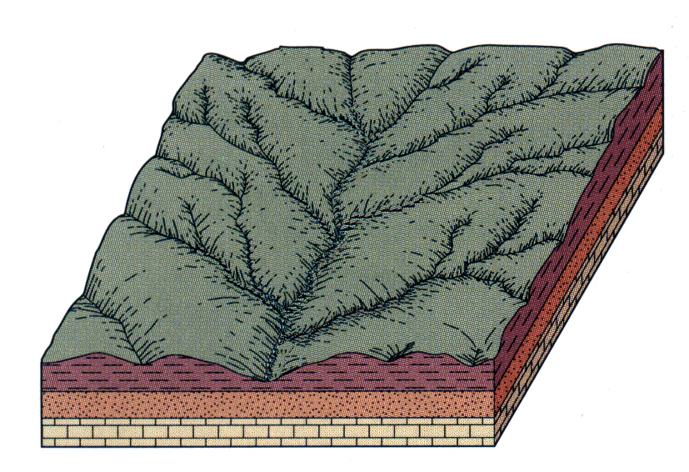
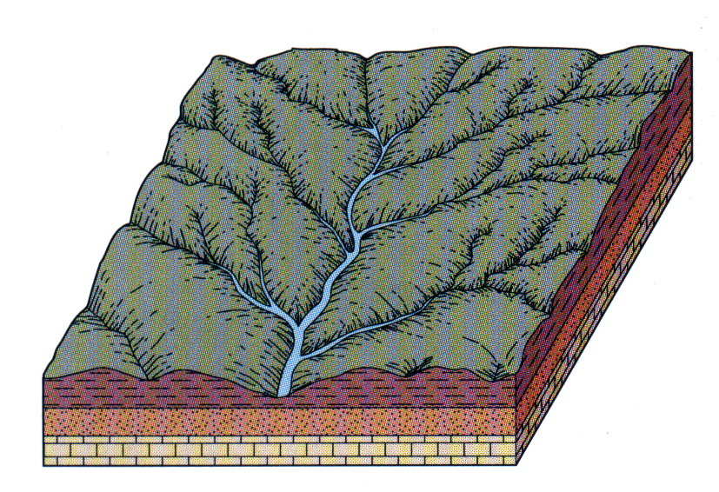

Slide 169
b. Radial
mountains / volcanoes

Slide 170
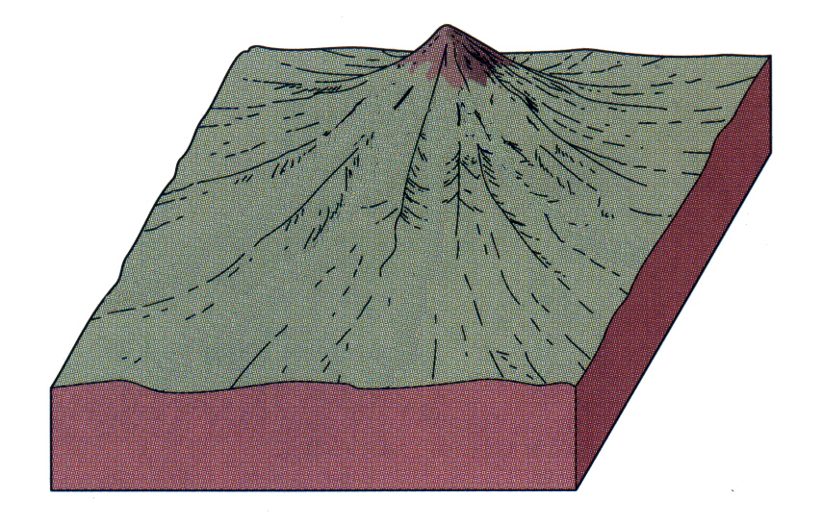
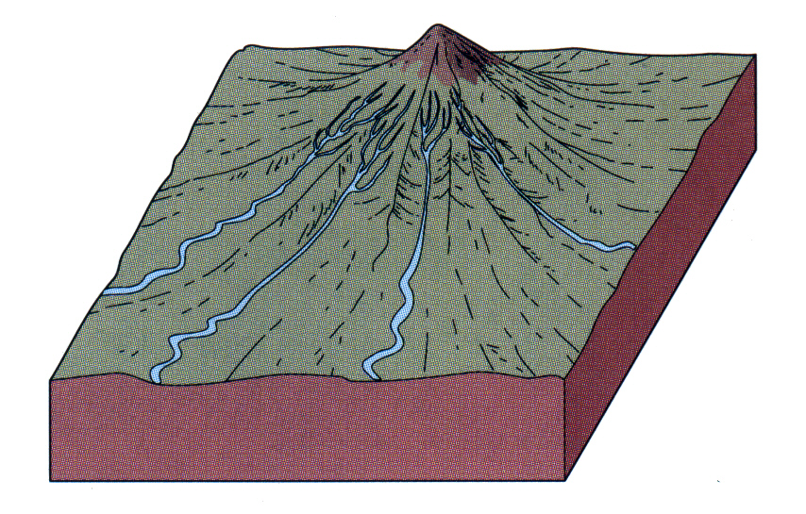

Slide 171
c. Trellis
hill-valley systems

Slide 172
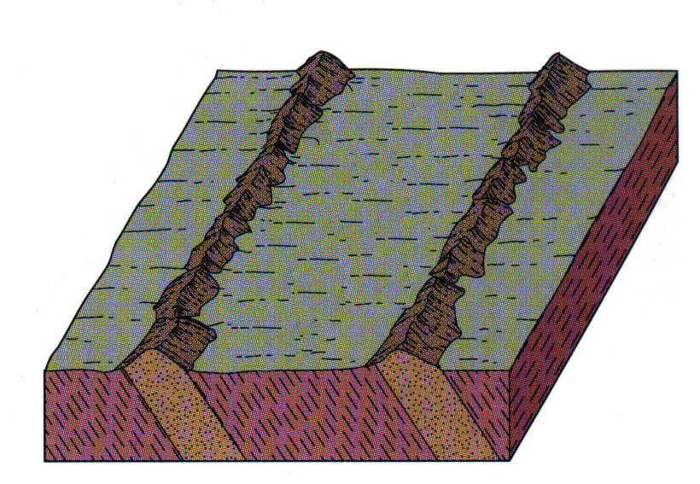
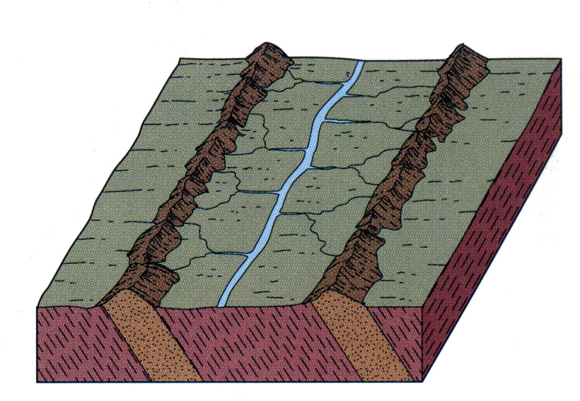

Slide 173
d. Annular
unevenly eroded
mountains

Slide 174
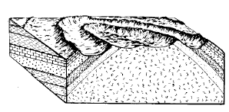
ANNULAR

Slide 175
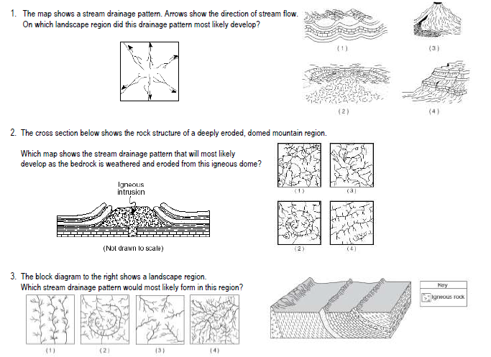

Slide 176
Page 279
6/1
AIM:
What are the properties of
different landscape regions?
( & using the ESRT pages 2 & 3 )

Slide 182
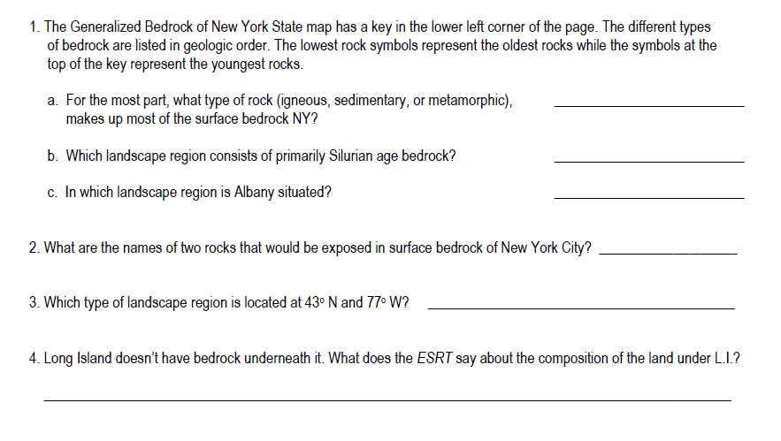

Slide 183
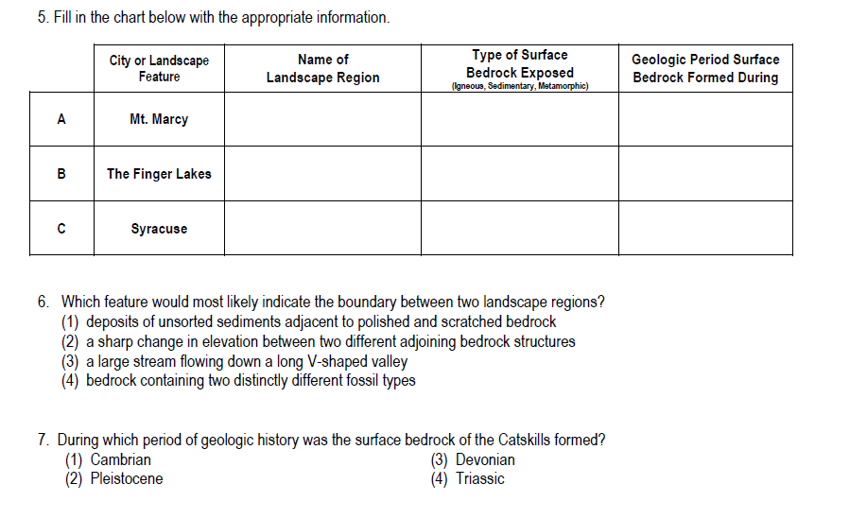

Slide 185
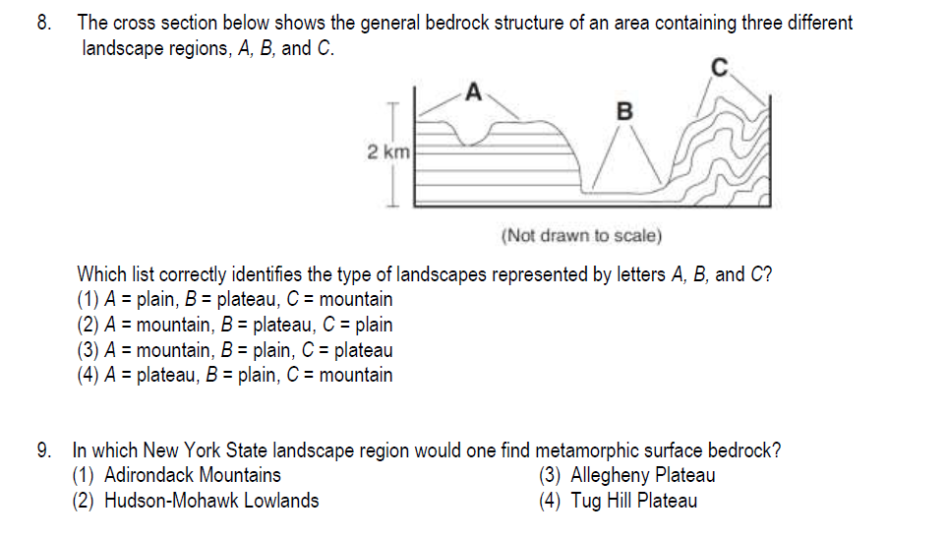

Slide 186
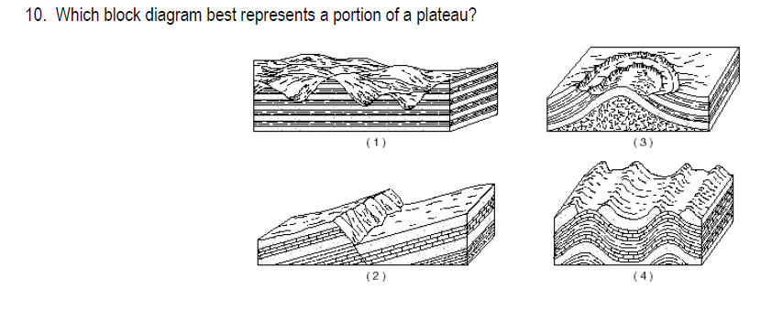

Slide 187
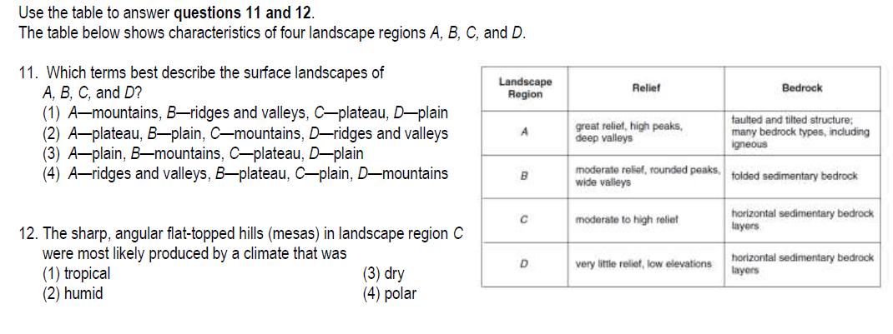

Slide 190
Good Morning! 5/17
EPICENTERS QUIZ FIRST
Get a compass (make sure it is working) and scrap paper
Take out ESRT
AFTER QUIZ
Get yellow and green highlighters or colored pencils
Open to page 281
Take out ESRT pages 8-9

Slide 191
Do Now: 5/30
1. Hand in entire yellow packet
2. Open to page 283 in notes
3. Open to page 7 in ESRT
H
HW:
DO A SELF-CHECK OF YELLOW PACKET USING RED ANSWER KEYS – MAKE A LIST OF QUESTIONS YOU WANT ME TO GO OVER

Slide 192
Do Now: 6/5
Hand in first page of orange packet
Get pink and blue
Open to page 287 in notes
HW:
1. Tan Packet Due Tomorrow
2. Blue Packet Due Friday

Slide 193
Happy Monday! 5/23
A last-minute change of plans Please open to page 288
Today we will work on the 2nd to last AIM
of the entire year!!!

Slide 194
THIS IS IT! (Almost …) 5/24
First Up! Practice Time
Do questions on pages 289-290
HW:
Complete the Regents Review Packet by Tuesday 5/31

Slide 195


Slide 196


Slide 197


Slide 198


Slide 199


Slide 200
THIS IS IT! (Almost …) 6/5
1. Hand in ANSWER SHEET
to pink packet
2. Open to p. 289-290
HW:
Complete Practice Regents 1 gray packet by tomorrow

Slide 201
The FINAL Aim!
p.289-290
6/5
How is the
Absolute Age
of a Rock Determined?

Slide 202
Finding the actual numerical age of a rock.
Absolute Age Dating

Slide 203


Slide 204


Slide 205


Slide 206


Slide 207
What is radioactive decay?
The natural breakdown of an unstable element into a more stable one (decay product).

Slide 209
What is a half-life?
The time it takes for half of a radioactive material to break down and become the decay product.
it’s basically the
rate of decay

Slide 211
What radioactive isotopes are used in absolute age dating?

Slide 213
Carbon-14
Used to date recent fossils
(less than 50,000 years old)

Slide 215
Uranium-238
Used to date oldest rocks on Earth. (4.5 x 10⁹ yrs old)

Slide 216
What factors affect the radioactive decay rate?
“NOTHING”

Slide 217
So How Does it Work?
It’s best to set up a chart …
Absolute Age Dating

Slide 218
Number of Half-Lives | % Radioactive Material Remaining | % Stable Decay Product Formed | Fraction Radioactive Material Remaining | Fraction Stable Decay Product Formed | Age of Rock
0
1
2
3

Slide 219
Time 0

Slide 220

Number of Half-Lives | % Radioactive Material Remaining | % Stable Decay Product Formed | Fraction Radioactive Material Remaining | Fraction Stable Decay Product Formed | Age of Rock
0
1
2
3
100%
0%
1
0
“0”yrs

Slide 221
1 Half-Life

Slide 222

Number of Half-Lives | % Radioactive Material Remaining | % Stable Decay Product Formed | Fraction Radioactive Material Remaining | Fraction Stable Decay Product Formed | Age of Rock
0
1
2
3
100%
0%
1
0
“0” yrs
50%
50%
1/2
1/2
5700 yrs

Slide 223
2 Half-Lives

Slide 224

Number of Half-Lives | % Radioactive Material Remaining | % Stable Decay Product Formed | Fraction Radioactive Material Remaining | Fraction Stable Decay Product Formed | Age of Rock
0
1
2
3
100%
0%
1
0
“0” yrs
50%
50%
1/2
1/2
5700 yrs
25%
75%
1/4
3/4
11400 yrs

Slide 225
3 Half-Lives

Slide 226

Number of Half-Lives | % Radioactive Material Remaining | % Stable Decay Product Formed | Fraction Radioactive Material Remaining | Fraction Stable Decay Product Formed | Age of Rock
0
1
2
3
100%
0%
1
0
“0” yrs
50%
50%
1/2
1/2
5700 yrs
25%
75%
1/4
3/4
11400 yrs
12.5%
87.5%
1/8
7/8
17100 yrs

Slide 228
Number of Half-Lives | % Radioactive Material Remaining | % Stable Decay Product Formed | Fraction Radioactive Material Remaining | Fraction Stable Decay Product Formed | Age of Rock
0
1
2
3
100%
0%
1
0
“0” yrs
50%
50%
1/2
1/2
25%
75%
1/4
3/4
12.5%
87.5%
1/8
7/8

Slide 229
100%
stable
product
radioactive
material
0%
time

Slide 230
1. Why are radioactive materials useful for
measuring geologic time?
(1) The disintegration of radioactive materials
occurs at a predictable rate.
(2) The half-lives of most radioactive materials
are less than five minutes.
(3) The ratio of decay products to undecayed
material remains constant in sedimentary rocks.
(4) Measurable samples of radioactive materials are
easily collected from most rock types.

Slide 232
2. After one half-life, how much of the
original sample of U²³⁸ would remain?
(1) 12.5% (3) 50%
(2) 25.0% (4) 87.5%

Slide 233

3. If 25% of the radioactive
potassium-40 in a sample is
remaining, what is the approximate
age of the rock?
(1) 1.3 x10⁹ (3) 3.9 x10⁹
(2) 2.6 x10⁹ (4) 4.5 x10⁹

Slide 234


4. The diagram represents a sample of a
radioactive isotope.
Which diagram best represents the % of this radioactive isotope sample that will remain after 2 half-lives?

Slide 235
5. A fossil shell contains 25% of the
original amount of its carbon-14.
Approximately how many years ago
was this shell part of a living organism?
(1) 5,700 years ago
(2) 11,400 years ago
(3) 17,100 years ago
(4) 22,800 years ago

Slide 236
6. Fossil pollen has been recovered from
sediments deposited in late-Pleistocene
lakes.
The pollen’s geologic age can most
accurately be measured by using
(1) rubidium-87
(2) potassium-40
(3) oxygen-18
(4) carbon-14

Slide 238
x
x

Slide 239

7. Which graph best shows the
radioactive decay of carbon-14?

Slide 240
Time 0
Radioactive Material

Slide 241
After 1 half-life
Stable Decay Product
1/2 remains

Slide 242
After 2 half-lives
Stable Decay Product
1/4 remains

Slide 243
After 3 half-lives
Stable Decay Product
1/8 remains

Slide 244
Time 0
Radioactive Material

Slide 245
After 1 half-life
Stable Decay Product
Radioactive
Material

Slide 246
After 2 half-lives
Stable Decay Product
Radioactive
Material

Slide 247
After 3 half-lives
Stable Decay Product
Radioactive
Material

Slide 248
This is the LAST DAY I will be teaching you ☹.
Tomorrow: DAY OFF
Friday: Topic Exam
Monday: ??
6/16

Slide 252
Time 0
AGE= 0 years old
16/16 =1
0/16 = 0
100% C14
0% N14

Slide 253
1 Half-Life
AGE= 5.7x10³ yrs old
(5700 yrs old)
1/2
1/2
50% C14
50% N14

Slide 254
2 Half-Lives
AGE= 11400 yrs old
1/4
3/4
25% C14
75% N14

Slide 255
3 Half-Lives
AGE= 17100 yrs old
1/8
7/8
12.5% C14
87.5% N14

Slide 256
x
x

Slide 259
Number of Half-Lives | % Radioactive Material Remaining | % Stable Decay Product Formed | Fraction Radioactive Material Remaining | Fraction Stable Decay Product Formed | Age of Rock
0
1
2
3
100%
0%
16/16
0/16
“0” yrs
50%
50%
1/2
1/2
25%
75%
1/4
3/4
12.5%
87.5%
1/8
7/8

Slide 260
If the age of a rock is determined to be
3.9 x 10⁹ years old, what fraction of
the original radioactive K⁴⁰ would be found
in the rock?

Slide 261
Time 0
Potassium-40

Slide 262
After 1 half-life
1.3 x 10⁹ years
Argon 40
1/2 remains

Slide 263
After 2 half-lives
2.6 x 10⁹ years
Argon 40
1/4 remains

Slide 264
After 3 half-lives
3.9 x 10⁹ years
Argon 40
1/8 remains

Slide 266
Time 0

Slide 267
1 Half-Life

Slide 268
2 Half-Lives

Slide 269
3 Half-Lives

Slide 270
Could This Be?
Is it Possible?
The Last Aim of the Year?!
Page 295 6/1
Bye

Slide 271
x
x

Slide 274

1

Slide 275

2

Slide 276

3

Slide 277

4

Slide 278

8-10

Slide 279
x
x

Slide 280

11

Slide 281


12

Slide 282

13

Slide 283


14

Slide 284

15

Slide 285
17-18

Slide 286
18

Slide 287

19-20

