Slide 1
Plate Tectonics Quiz!!
(take out ESRT and glossaries)
If you finish early, work on Regents review packet

Slide 2
First Regents Review Assignment Due May 24
Pages 1-14 #1-38
Pages 15-22 #39-80
due May 31

Slide 3
Regents Earth Science
Topic X: Part 2
EARTHQUAKES

Slide 4

What are the properties of earthquakes?
Page 263
5/15
AIM:

Slide 5
1. What are earthquakes and where do they occur?
Any vibrating, shaking, or rapid motion of the Earth’s crust.

Slide 6
What are earthquakes and where do they occur?
Any vibrating, shaking, or rapid motion of the Earth’s crust.
Mainly caused by faulting.

Slide 7

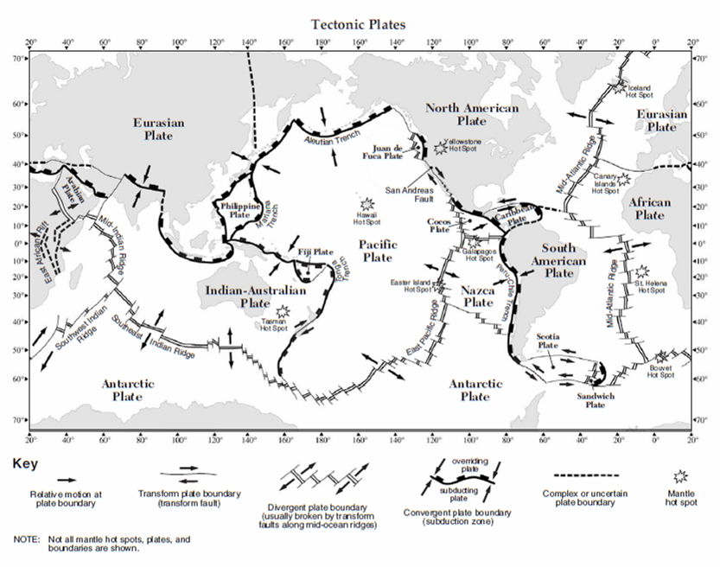

Slide 8
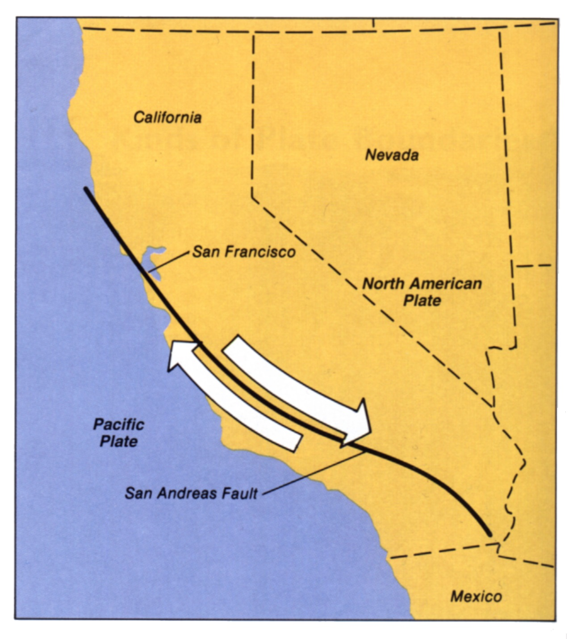
San
Andreas
Fault
California

Slide 9
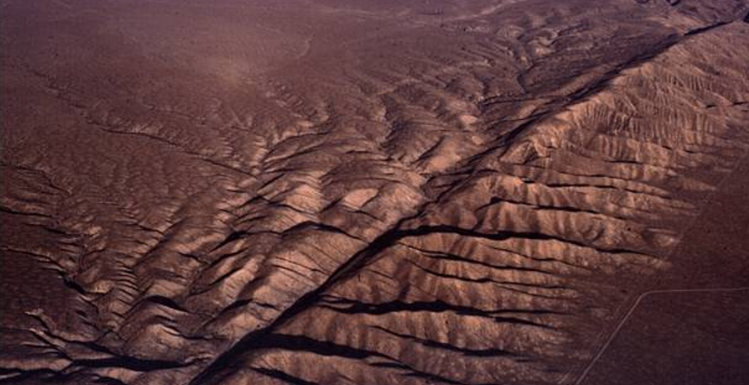
San Andreas Fault - California

Slide 10
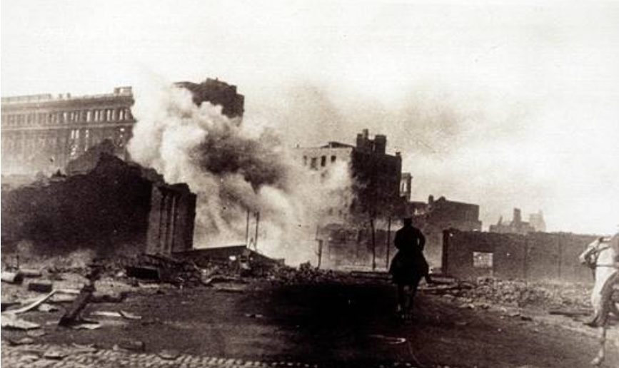
San Francisco - 1906

Slide 11
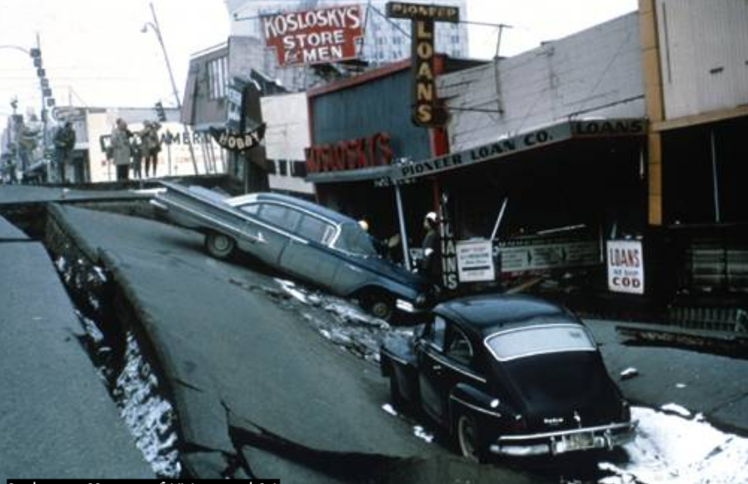
Alaska - 1964

Slide 12
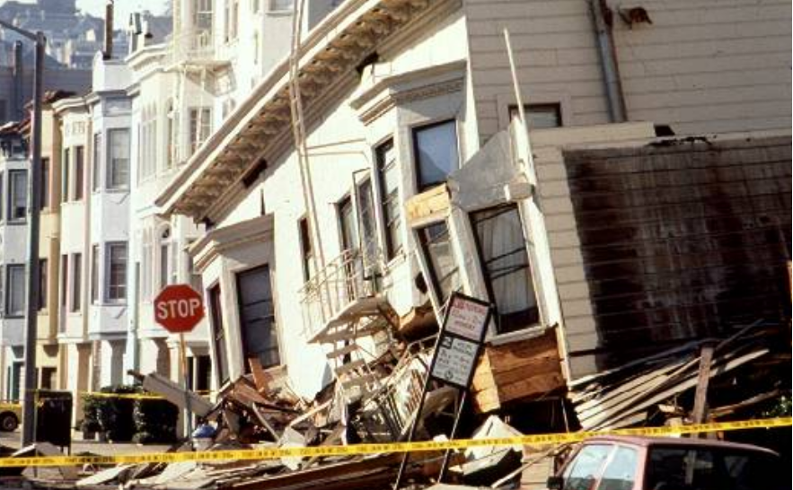
Loma Prieta (S.F.) - 1989

Slide 13
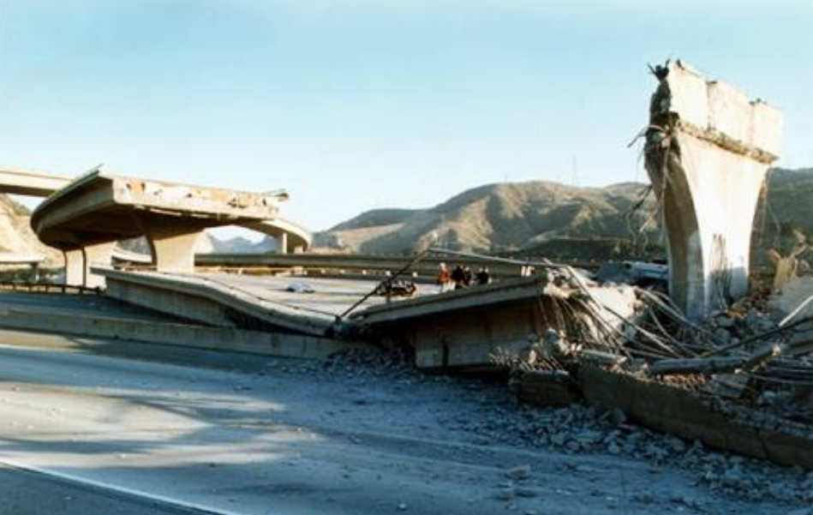
Los Angeles - 1994

Slide 14
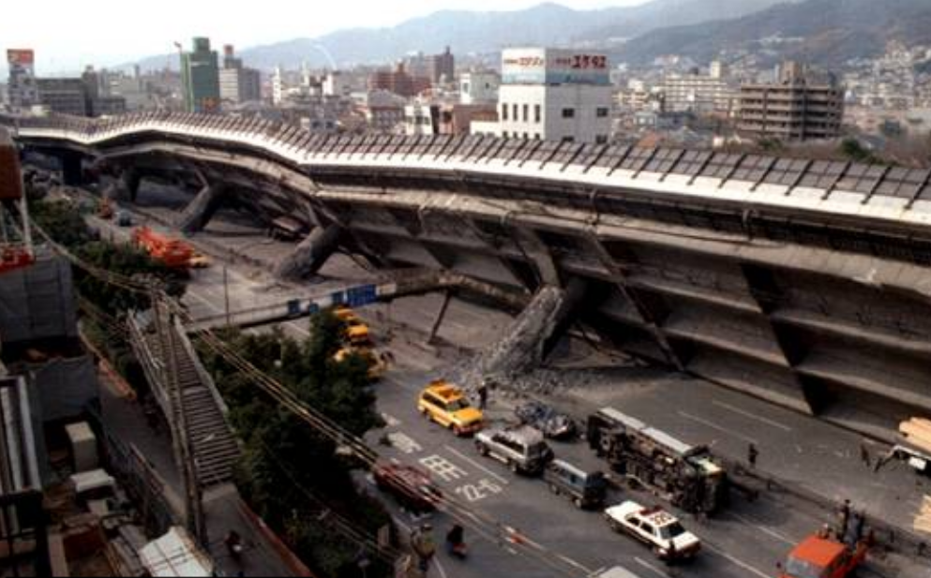
Kobe, Japan -1995

Slide 15
2. What is the difference between the earthquake focus and epicenter?

Slide 16
crust
epicenter
fault
focus

Slide 17
What is the difference between the earthquake focus and epicenter?
FOCUS - actual place EQ begins
EPICENTER
The point on the Earth’s
surface right above the focus
where EQ is felt most strongly

Slide 18
3.
What is a tsunami?

Slide 19
TSUNAMI
A very large ocean wave caused by an underwater earthquake or volcanic eruption

Slide 20
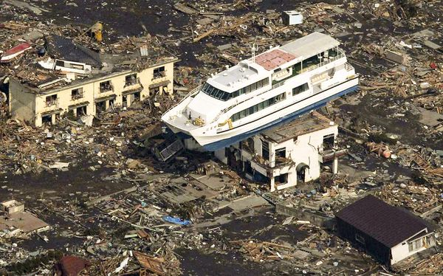
TSUNAMI

Slide 22
4. What are the two scales used to measure an earthquake?

Slide 23
Mercalli Scale
1873
Measures intensity of earthquake based on observations and resulting damage.
I-XII

Slide 24
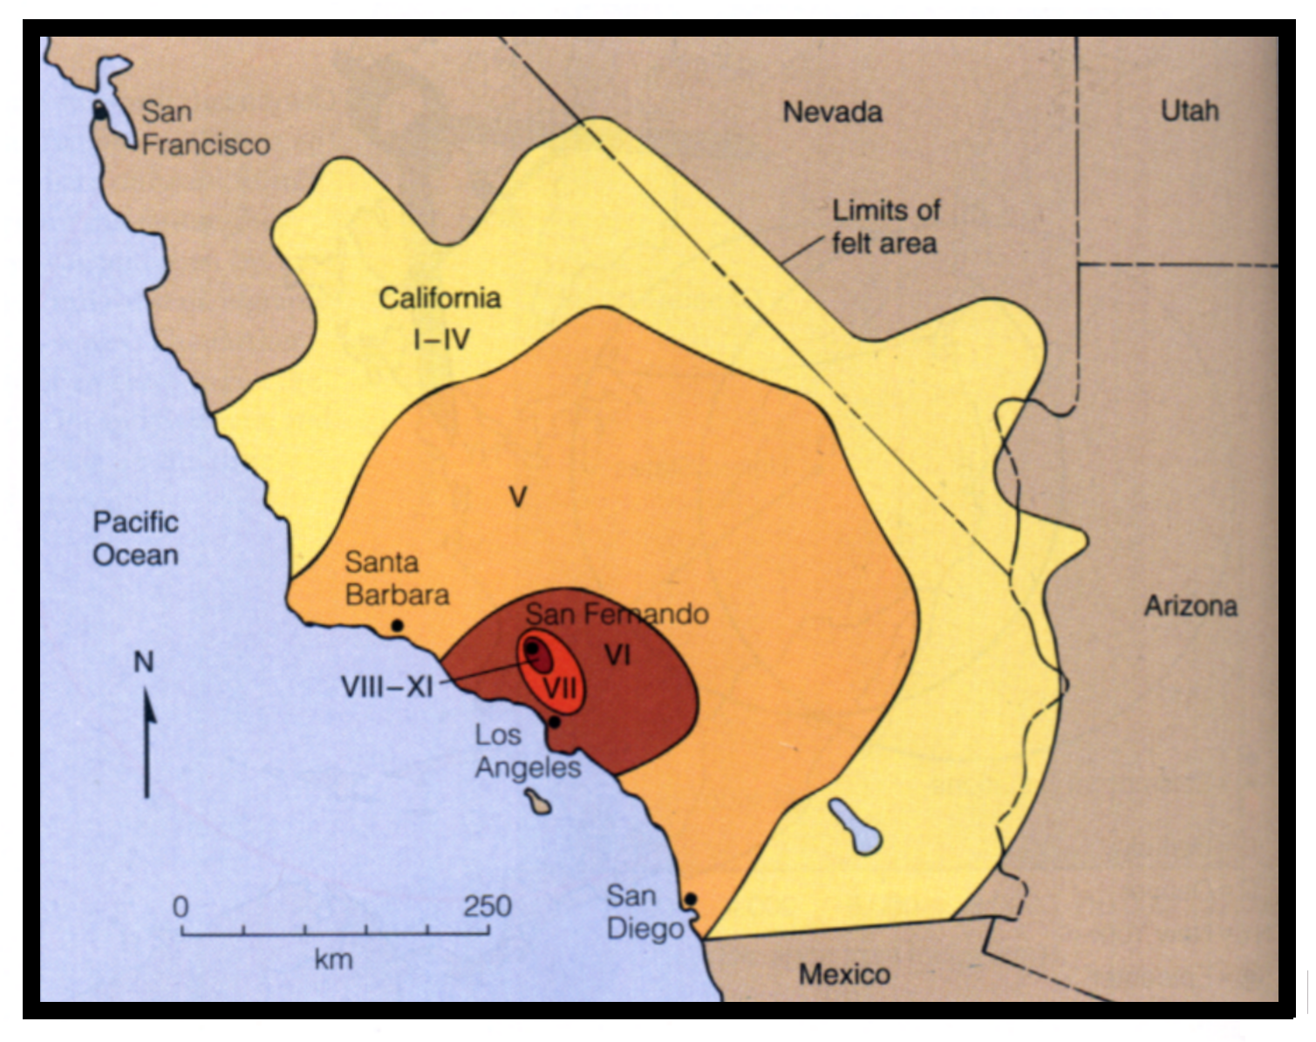

Slide 25
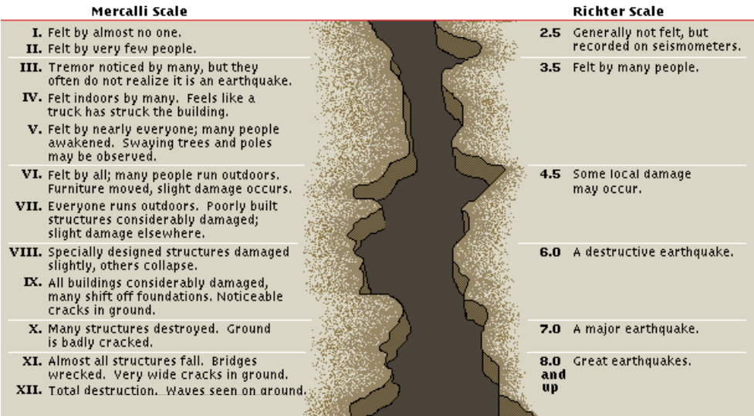

Slide 26
Mercalli Scale
1902
Measures intensity of earthquake based on observations and resulting damage.
I-XII
Richter Scale
1935
Measures magnitude of earthquake (energy released) using a seismograph.
1-10

Slide 27
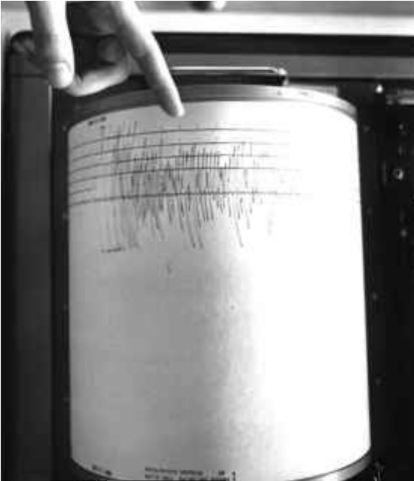
seismograph
seismogram

Slide 28
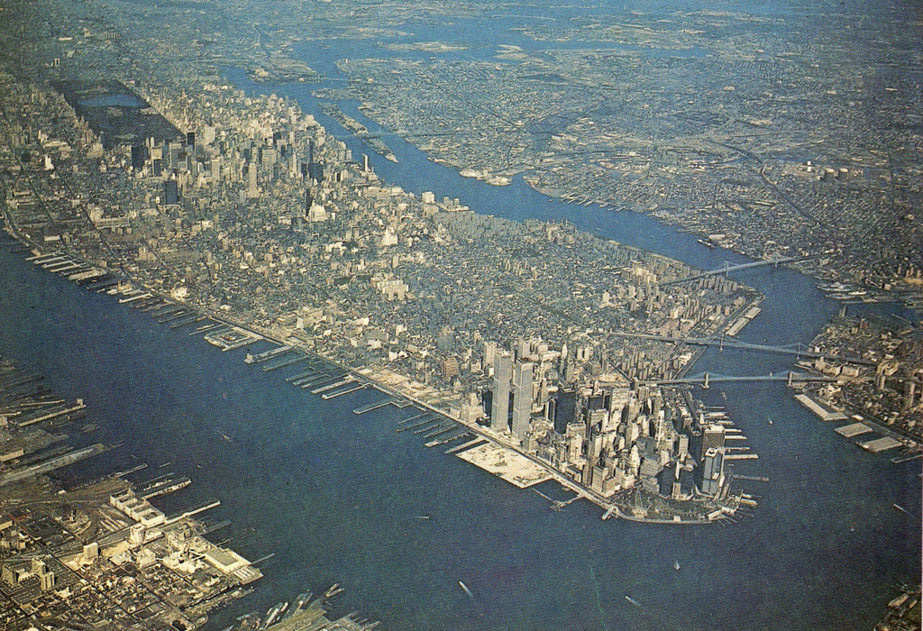
Manhattan Skyline

Slide 29

Manhattan Skyline

Slide 30
What are the properties of seismic waves?
Page 265
5/15
AIM:

Slide 31
SEISMIC WAVES
Earthquake energy waves that travel through the Earth.

Slide 32
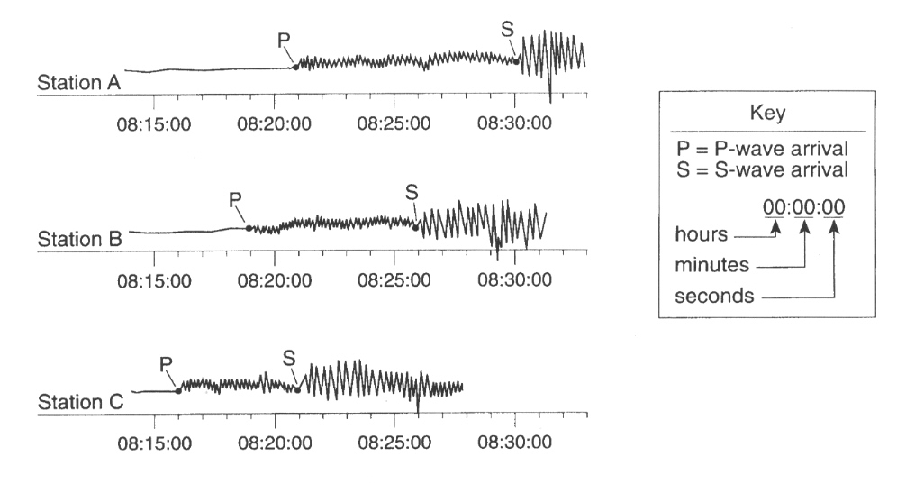

Slide 33
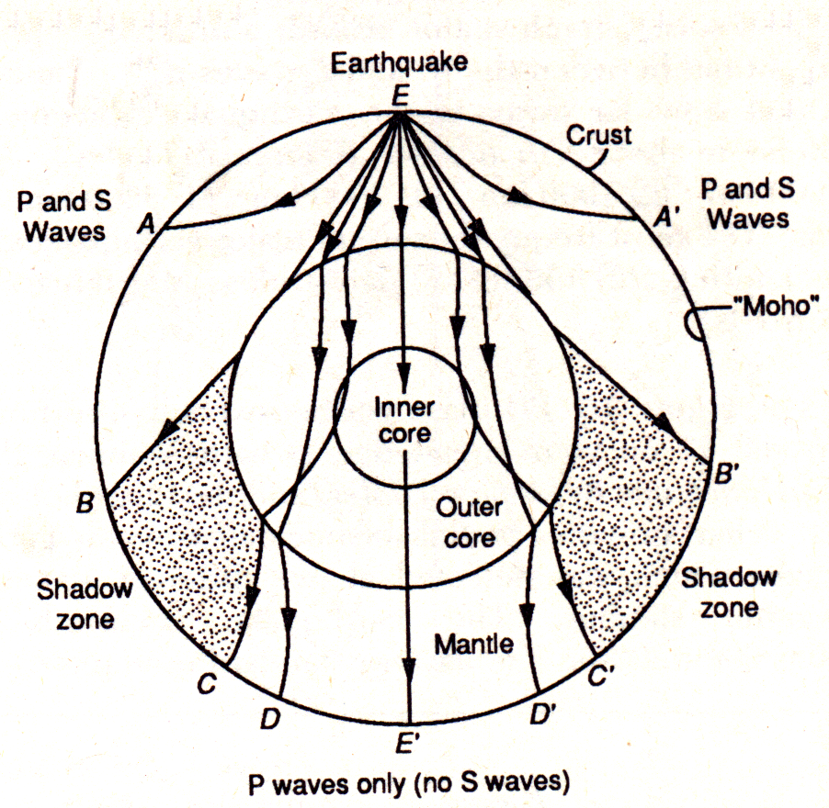

Slide 34
P-waves
Epicenter at “E” at 8:10:00
S-Waves
Station A
Station A’
Station B
Station B’
Station C
Station C’
Station D
Station D’
Station E’

Slide 35
P-Waves
1.
Primary Waves (Compressional)
Travel Fastest
Travel through solids and fluids

Slide 36

P-Waves
1.
Vibrate forward and backward

Slide 38
S-Waves
2.
Secondary Waves (Shear)
Slower than P-waves
Cannot travel through fluids
(best evidence that outer core is liquid)

Slide 39

S-Waves
2.
Vibrate up and down

Slide 42
Epicenter at “E” at 8:10:00
Station A
Station A’
Station B
Station B’
Station C
Station C’
Station D
Station D’
Station E’

Slide 43
Epicenter at “E” at 8:10:00
Station A
Station A’
Station B
Station B’
Station C
Station C’
Station D
Station D’
Station E’

Slide 44
Epicenter at “E” at 8:10:00
Station A
Station A’
Station B
Station B’
Station C
Station C’
Station D
Station D’
Station E’

Slide 46
Do Now: 5/15
Take Out Signed Calendar
2. Open to ESRT page 11
3. Work on Regents Review Packet
when done with test
HW:
YOU SHOULD BE WORKING ON REGENTS REVIEW WHEN THERE IS NO OTHER HW

Slide 47
Do Now: 5/21
Get a piece of scrap paper
Turn to page 267 in packet
Open to ESRT page 11
Finding the Distance to an Earthquake Epicenter
Key Terms and Dealing with Time Calculations

Slide 48
Page 266
Finding the Distance to an Earthquake Epicenter
Key Terms and Dealing with Time Calculations

Slide 49
S
P
5:07:00am 5:12:40am

Slide 51
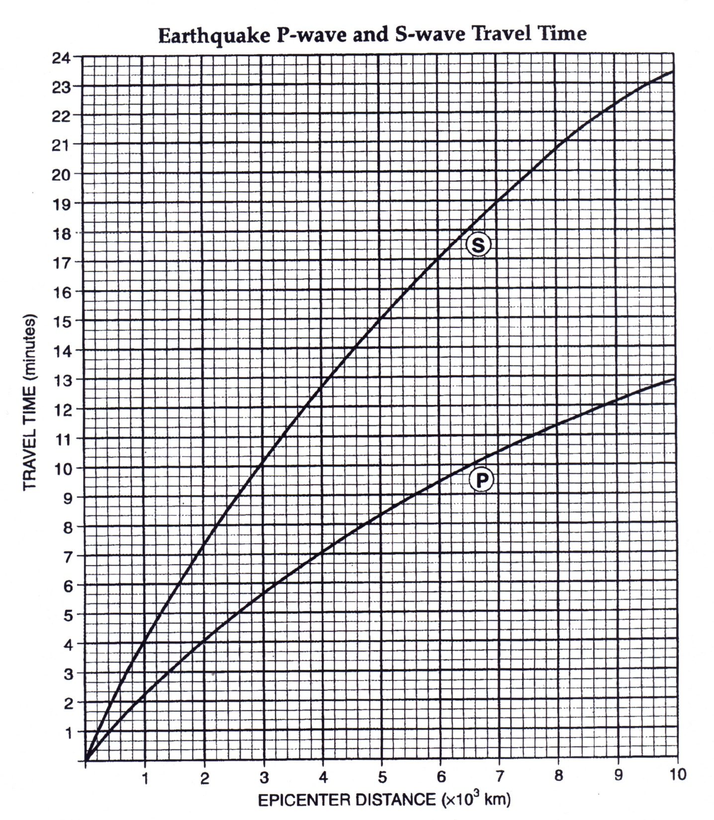
ESRT page 11

Slide 52
lag time
ESRT page 11

Slide 53
Epicenter at “E” at 8:10:00
Station A
Station A’
Station B
Station B’
Station C
Station C’
Station D
Station D’
Station E’

Slide 55
Hello! 5/16
Open to page 266
Open to ESRT page 11
Take Out Scrap Paper
HW:
First Regents Review Assignment Due May 24
Pages 1-14 #1-38

Slide 56
Page 266
Arrival Time Difference
(LAG TIME)
is crucial to find
Distance to Epicenter!

Slide 57
Pre-Lesson LESSON
Subtracting Time:
Here is a structured
way to do the math when subtracting time
(if needed).

Slide 59
Sample Problem - Bottom of page 266
P-Wave Arrival Time – 10:01:30pm
S-Wave Arrival Time – 10:06:40pm

Slide 60
P-Wave Arrival Time – 10:01:30pm
S-Wave Arrival Time – 10:06:40pm
Borrowing Time Technique
h m s
10:06:40
- 10:01:30
00
:05
:10
5 min 10 sec

Slide 61
Top of page 267
SOMETIMES YOU MIGHT HAVE TO “BORROW TIME” TO DO THE MATH
P-Wave Arrival Time – 11:30:20pm
S-Wave Arrival Time – 11:33:00pm

Slide 62
Borrowing Time Technique
P-Wave Arrival Time – 11:30:20am
S-Wave Arrival Time – 11:33:00am
Ex.1
32
60
11:33:00
- 11:30:20
00
:02
:40
2 min 40 sec

Slide 63
Borrowing Time Technique
P-Wave Arrival Time – 1:15:40am
S-Wave Arrival Time – 1:21:20am
Ex.2
20
80
1:21:20
- 1:15:40
00
:05
:40
5 min 40 sec

Slide 64
Practice Subtracting Time
Questions 1-4 on bottom of page 267

Slide 65
1
54
75
10:55:15
- 10:47:30
00
:07
:45
7 min 45 sec

Slide 66
2
18
70
12:19:10
- 12:14:40
00
:04
:30
4 min 30 sec

Slide 67
3
4:44:40
- 4:33:30
00
:11
:10
11 min 10 sec

Slide 68
4
7
66
8:06:20
- 7:58:20
00
:08
:00
8 min 00 sec

Slide 69
Finding the Distance to an EQ Epicenter:
Our First Sample Problem:
A P-wave arrived at a seismograph station at 5:40:00pm and the
S-wave arrived at 5:44:00pm.
What is the distance to the
earthquake epicenter?

Slide 71
Types of page 11
P & S-Wave Questions
(there are 4 types)
1. “Ride the P-Wave” (scrap needed)

Slide 72
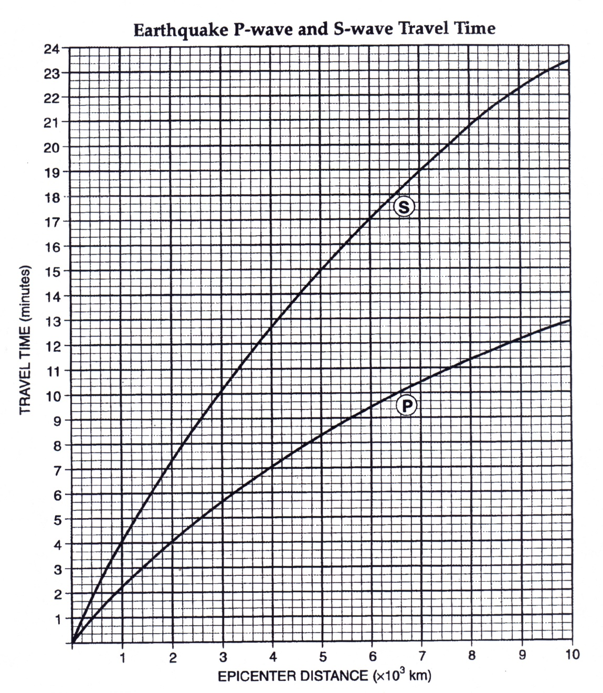
USING LAG TIME
TO FIND EPICENTER DISTANCE
Arrival Time Diff.
(LAG TIME)
ESRT page 11
Ride the P-Wave!

Slide 73
4
0
0

Slide 74
2.6 x 10³
or
2600 km
4
0

Slide 76
Page 269 # 1
What is the distance to an earthquake epicenter if the
P-wave arrival time is 2:31pm and the S-wave arrival time is 2:37pm?

Slide 78
Page 269 # 2
If the earthquake detection station records the difference in arrival times between P-and S-waves is
10 minutes 20 seconds, what is the distance to the earthquake epicenter from the recording station?

Slide 80
Types of page 11
P & S-Wave Questions
“Ride the P-Wave” (scrap needed)
“Just Go” (info is on chart – no math)

Slide 82
Page 269 # 3
If the earthquake epicenter is 9000 km away from a recording station, how long is the P-wave travel time to that station?

Slide 84
Page 269 # 4
If it takes 19 min and 40 sec for the
S-waves of an earthquake to reach a recording station, how far away is the earthquake epicenter from that station?

Slide 86
YAY Wednesday ! 5/17
Open to page 269
Open to ESRT page 11
Take Out Scrap Paper

Slide 88
Types of page 11
P & S-Wave Questions
“Ride the P-Wave” (scrap needed)
“Just Go” (info is on chart – no math)
“Origin Time Question” (X→⌂)

Slide 90
Page 269 # 5
If a seismograph station is 6600 km from an epicenter, and the P-wave arrived at this station at 7:30 a.m., at approximately what time did the earthquake occur?

Slide 92
Page 269 # 6
An earthquake struck a location at
1:35 p.m. If a seismograph station is 4000km from the earthquake epicenter, at what time would the first P-waves arrive at the seismograph station?

Slide 93
Types of page 11
P & S-Wave Questions
“Ride the P-Wave” (scrap needed)
“Just Go” (info is on chart – no math)
“Origin Time Question” (X→⌂)
“S after P: The Reverse Ride” (scrap)

Slide 94
ESRT page 11

Slide 95
Page 270 # 7
A seismic station is recording the seismic waves produced by an earthquake that occurred 3000km away.
How long after the arrival of the first
P-wave will the first S-wave arrive?

Slide 96
ESRT page 11

Slide 97
Page 272 # 8
An earthquake’s first P-wave arrives at a seismic station at 12:00:00.
This P-wave has traveled 6000 km from the epicenter.
At what time will the first S-wave from the same earthquake arrive at the seismic station?

Slide 98
ESRT page 11

Slide 99
Page 270 #9

Slide 100
Understanding Seismic Data

Slide 101
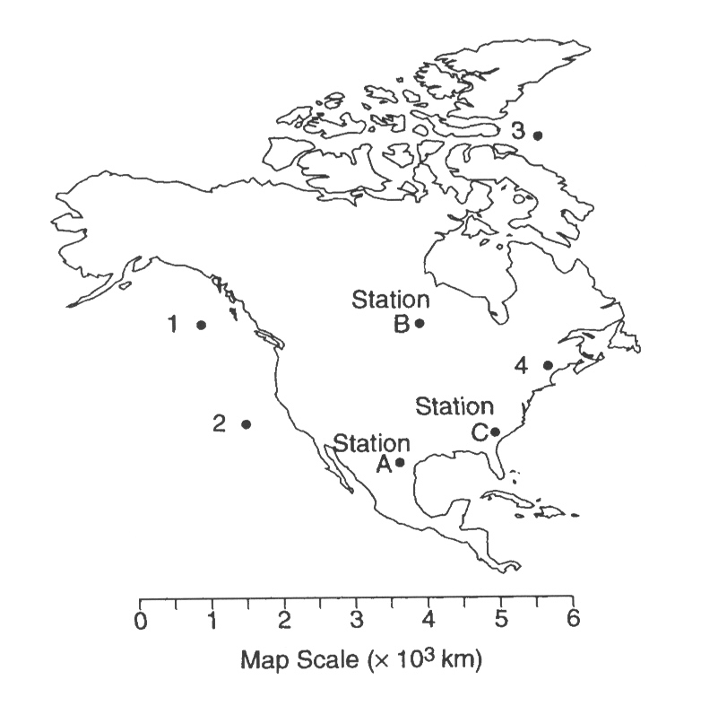
Pinpointing the Earthquake Epicenter
Distance from Station A
2100km
0 1000 2000 3000
kilometers

Slide 102
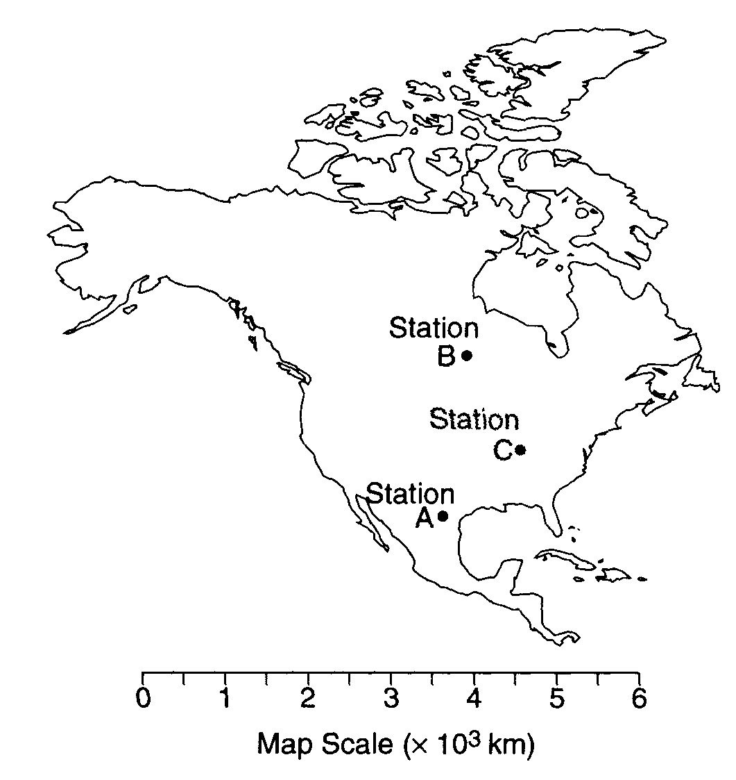
Distance from Station A
2100km
0 1000 2000 3000
kilometers

Slide 103
Distance from Station B
2600km
0 1000 2000 3000
kilometers

Slide 104
Distance from Station B
2600km
0 1000 2000 3000
kilometers

Slide 105
Distance from Station C
1300km
0 1000 2000 3000
kilometers

Slide 106
Distance from Station C
1300km
0 1000 2000 3000
kilometers

Slide 107
Page 270 #10

Slide 108
seismograph
instrument used to detect earthquake waves
seismogram
data produced by a seismograph

Slide 111
WORK TIME!! 5/17
Epicenter Lab (Due Friday)
*Lab Quiz Friday*
Pages 271-273 (Due Friday)
Yellow Regents Review Packet
pages 1-14 due next Wed.

Slide 112
Welcome Back from all that Testing!
5/12
Please have ready:
1. ESRT page 11
2. Scrap Paper
3. Page 271 in packet
I will review/teach you a bit and then you will have some work time

Slide 113
ESRT page 11

Slide 114
5/13
Please Open to page 272
Today
Review of Earthquake Questions
If time, work on Regents Review
Finding Epicenters Quiz on Tuesday

Slide 115
Page 273
Example 1:
Following an earthquake, a seismograph station recorded
the arrival of a P-wave at 1:05:00 a.m. and an S-wave at
1:14:30 a.m. What is the distance from the seismograph
station to the epicenter of the earthquake?

Slide 116
ESRT page 11

Slide 117
Example 2:
How far does an earthquake P-wave
travel in 3 minutes 40 seconds?

Slide 118
ESRT page 11

Slide 119
Example 3:
The distance from a seismic recording station to an earthquake epicenter is 1800km. The station recorded the arrival of the first P-waves from the earthquake at 5:06pm. What time would the
first S-waves arrive at the recording station?

Slide 120
ESRT page 11

Slide 121
Example 4:
A seismographic station determines that its distance from the epicenter of an earthquake is 3000 kilometers. If the P-wave arrived at the station at 9:10:00 a.m., the time of the earthquake's origin was

Slide 122
ESRT page 11

Slide 123
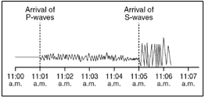
Example 5:
According to the data in the seismogram, what is the distance to the epicenter?

Slide 124
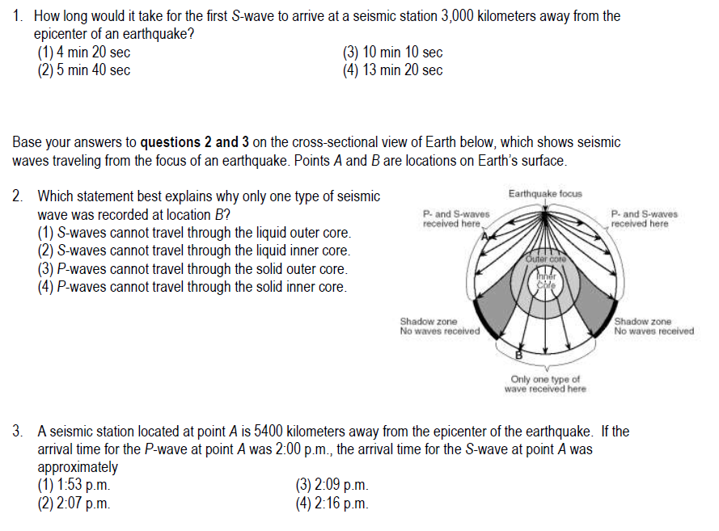

Slide 125
ESRT page 11

Slide 126
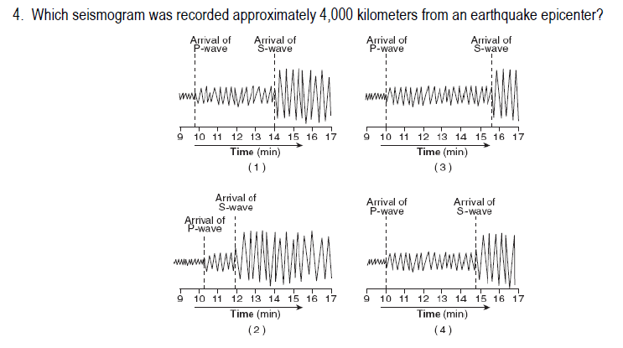

Slide 127
ESRT page 11

Slide 128
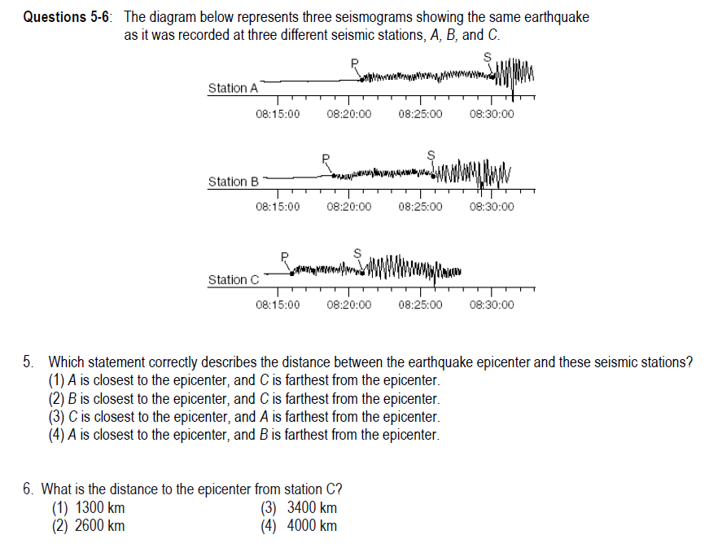

Slide 129
ESRT page 11

Slide 130
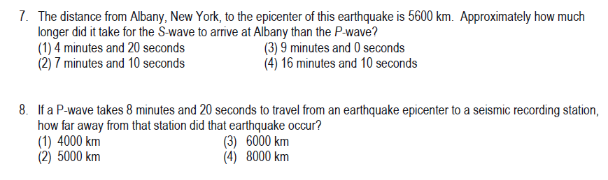

Slide 131
ESRT page 11

Slide 132
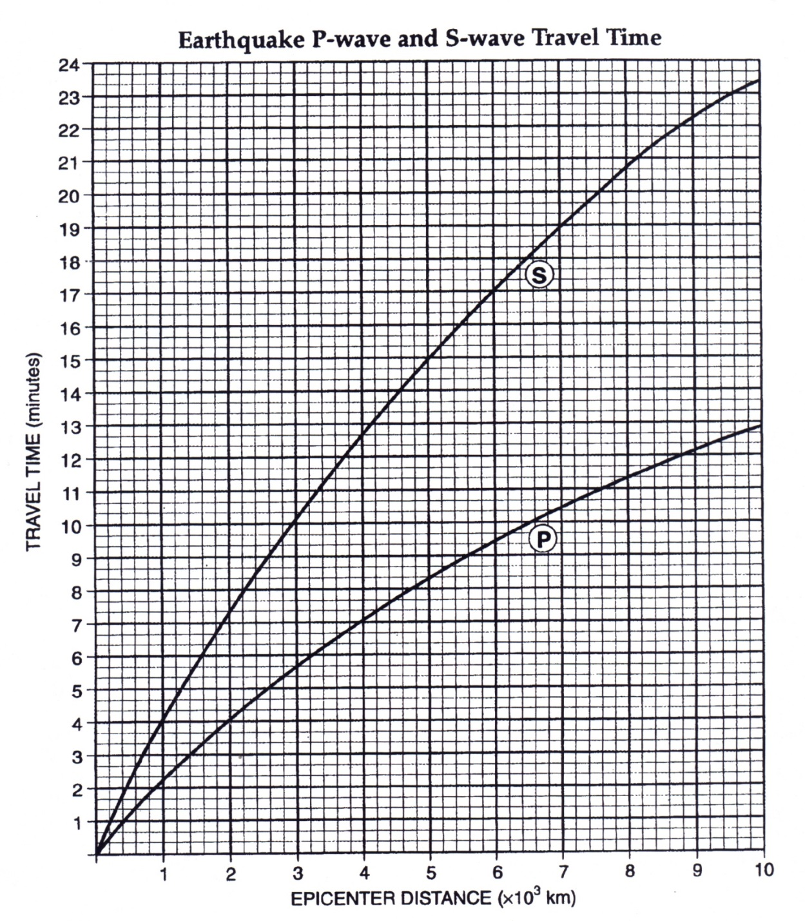
a. P-Wave Arrival Time
b. S-Wave Arrival Time
c. Arrival Time Difference (Lag Time)
d. Distance to Epicenter
e. P-Wave Travel Time
f. S-Wave Travel Time
g. EQ Origin Time

Slide 133
a. P-Wave Arrival Time
b. S-Wave Arrival Time
c. Arrival Time Difference (Lag Time)
d. Distance to Epicenter
e. P-Wave Travel Time
f. S-Wave Travel Time
g. EQ Origin Time

Slide 134
Do Now: 5/18
Hand in Lab
Open to page 271
Open to page 11 in ESRT
Have scrap paper ready to use
HW:
1st Regents Review Assignment - MON
Epicenter Lab Quiz - TUE

Slide 135
0 1000 2000 3000
kilometers

