Slide 1
5/3
TEST TIME!!
Woo hoo!!
Fun Fun!!

Slide 2
Regents Earth Science
Topic X: Part 1
PLATE TECTONICS

Slide 3
What are the properties of
Earth’s interior?
Page 252
5/3
Aim:

Slide 4

May the 4th be with You!
Please open to ESRT page 10 and notes page 252

Slide 6
This chart is also in your
ESRT
page 10

Slide 7
1. Knowledge of
Earth’s interior is based on
studies of
seismic waves
When Earth formed, it separated into layers based on
different material’s density differences

Slide 9
2a.
THICKER
(esp. under mountains)
2b. THINNER

Slide 10
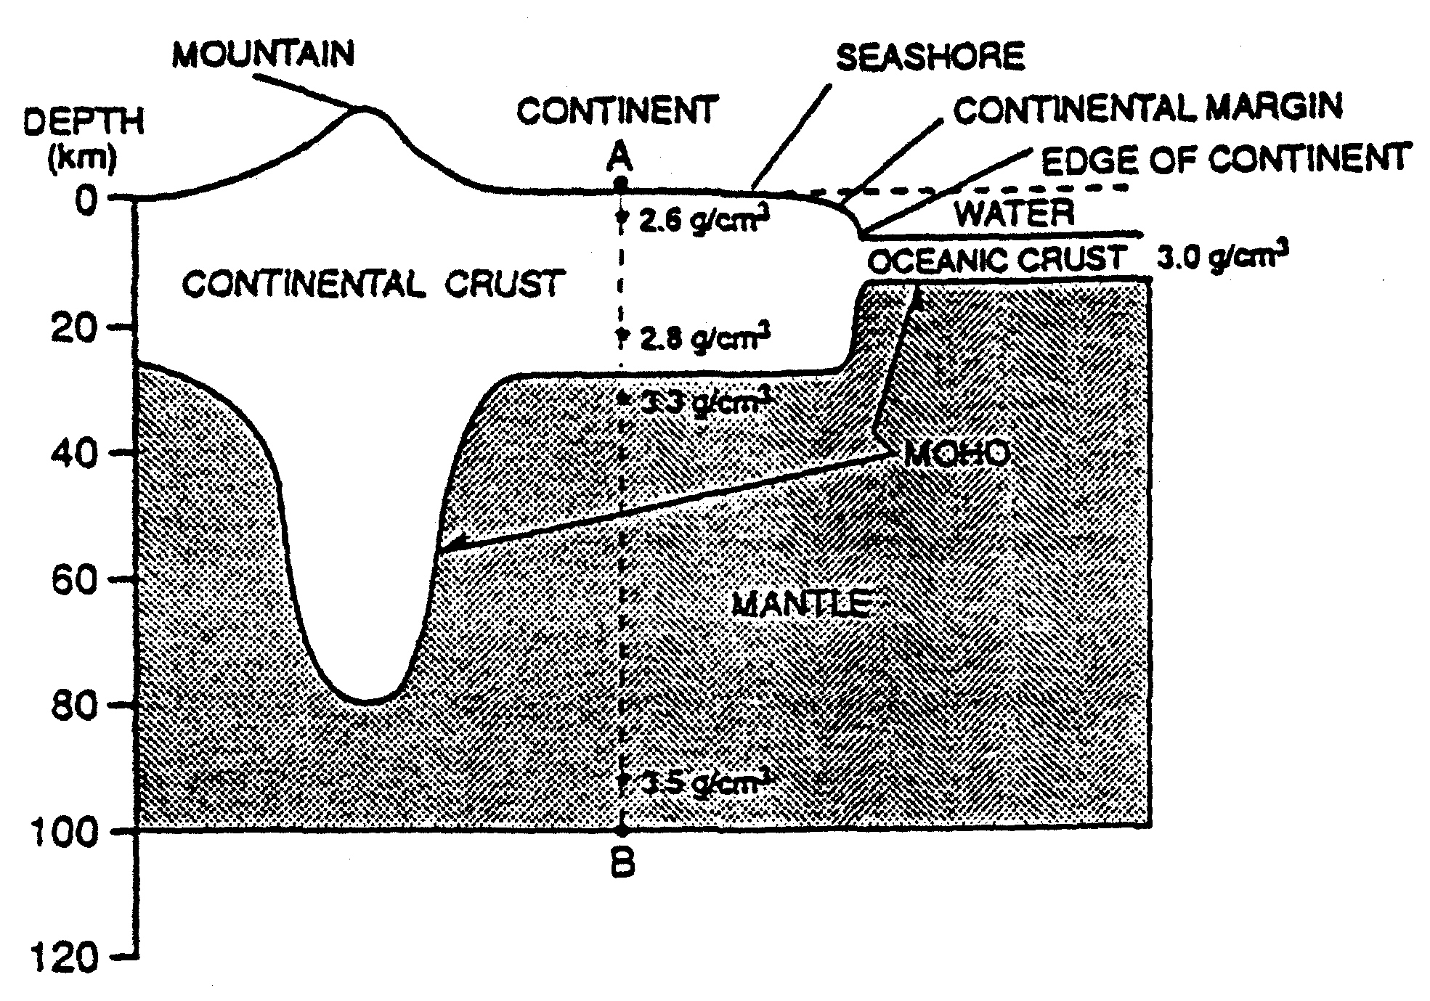

Slide 11
3.
MOHO
boundary between crust and mantle

Slide 14
4. Asthenosphere
convection currents allow flow of material

Slide 15
5.
Outer Core
LIQUID!!

Slide 16
LIQUID!!

Slide 19
6.
As depth increases, pressure increases.

Slide 20
7.
As depth increases, temperature increases.

Slide 21
To round out the period:
5/4
Open to ESRT page 5
We are going to color!
red, blue, green, and orange
(to be continued …)
Do questions on pages 253-254
Complete for HW

Slide 22

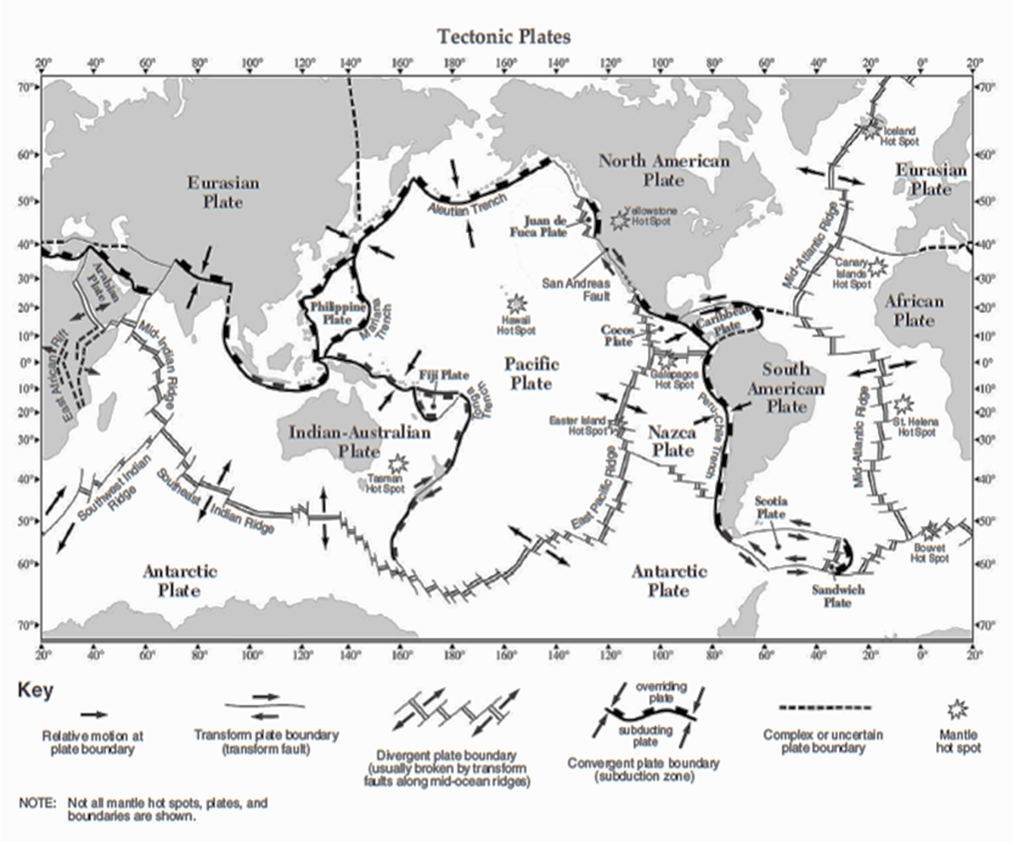
ESRT page 5

Slide 23
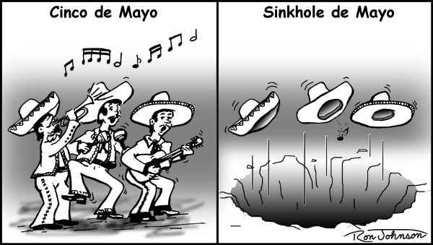
Happy Cinco de Mayo!
5/5
Open to Classwork/HW
pages 253-254

Slide 24
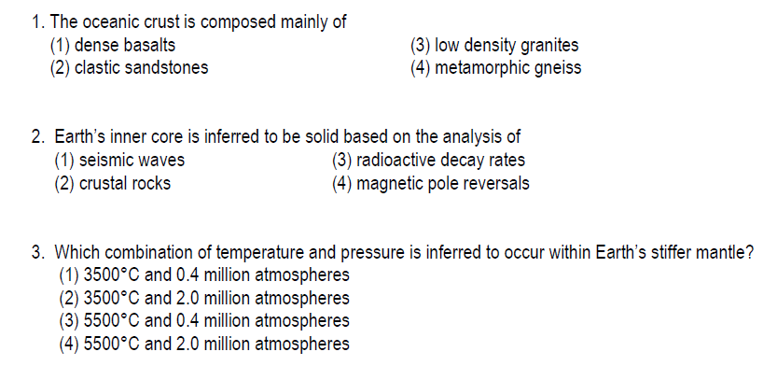

Slide 27
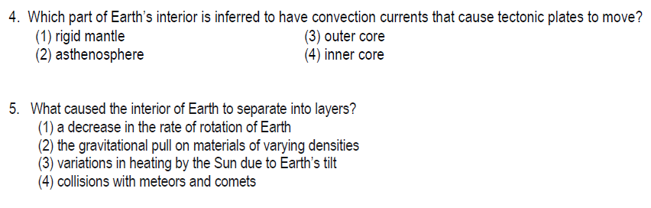

Slide 28
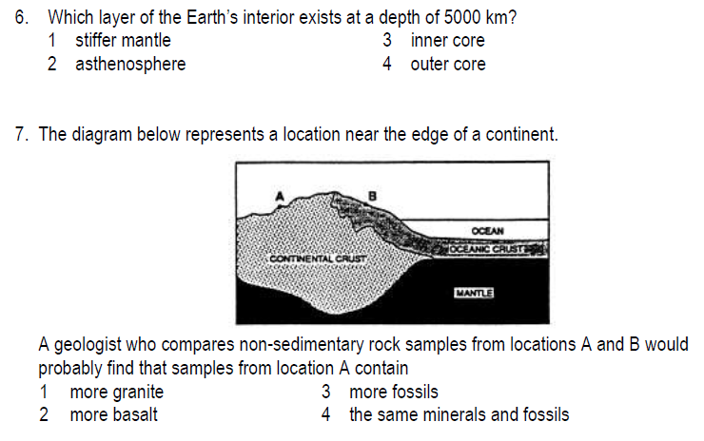

Slide 29
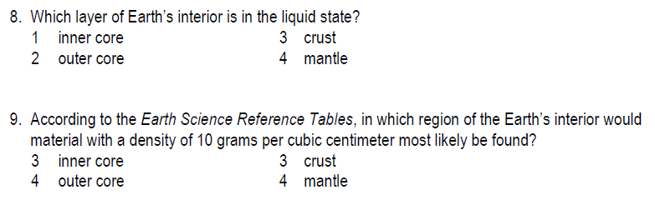

Slide 30
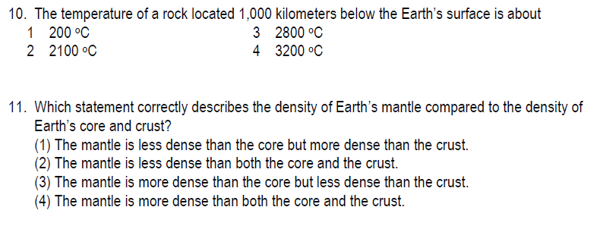

Slide 31
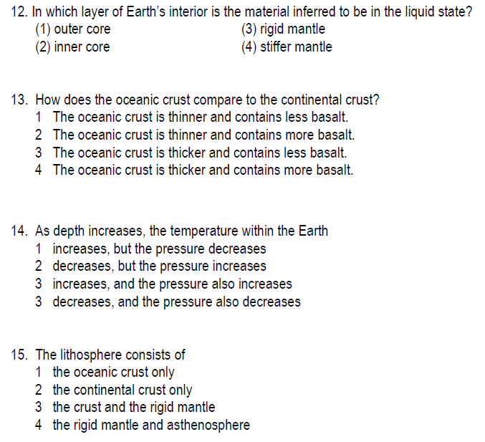

Slide 32
How do we know that Earth’s crust has shifted over time?
Page 255
5/5
AIM:

Slide 33
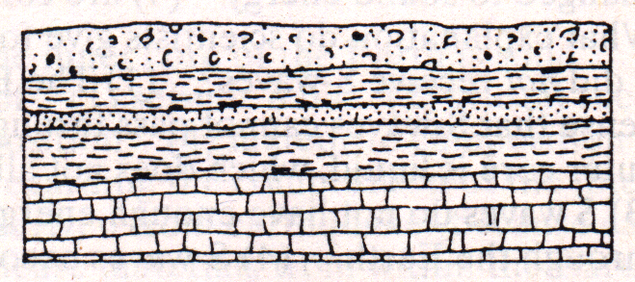
1. What is strata?
Horizontal layers of sedimentary rock.
Indicates no crustal movement

Slide 34
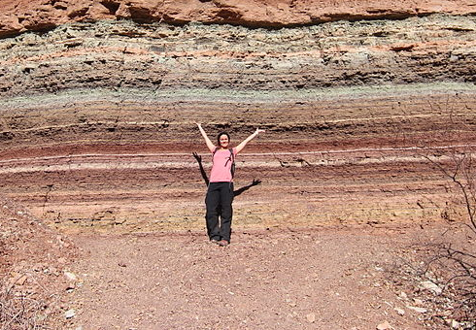
strata

Slide 35
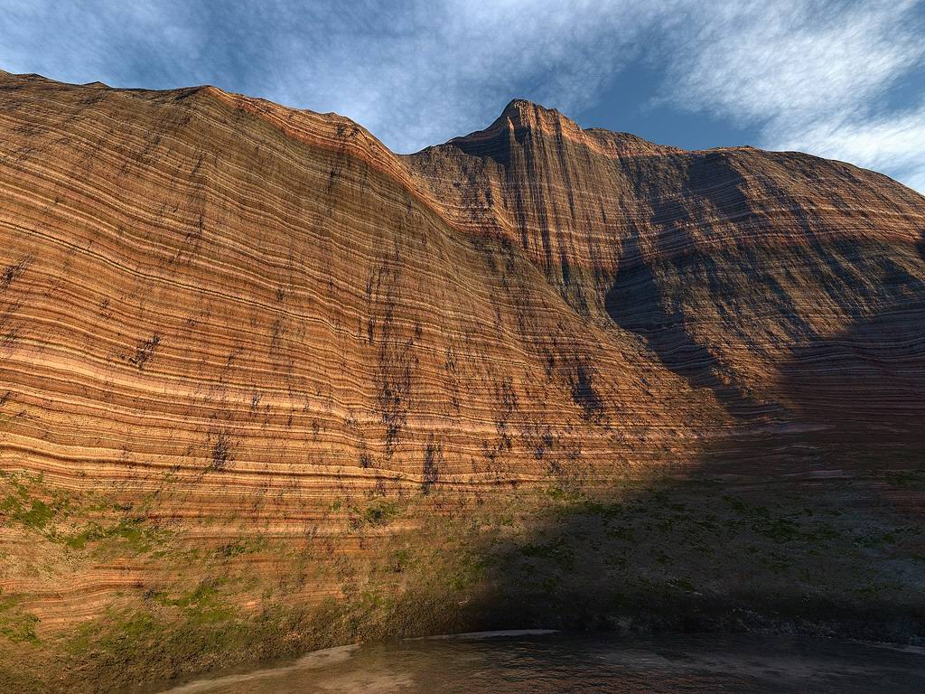
strata

Slide 36

2.
What events show evidence of crustal movement?

Slide 37
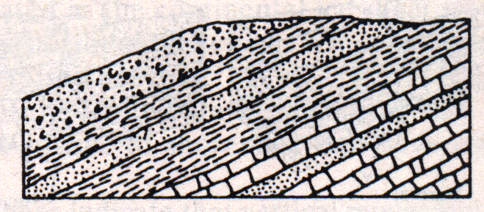
A
Tilting
strata is shifted to an angle
away from its original
horizontal deposition

Slide 38
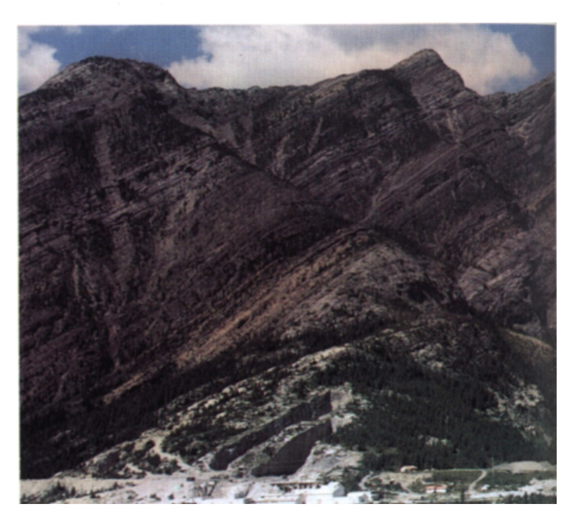
A
Tilting

Slide 39
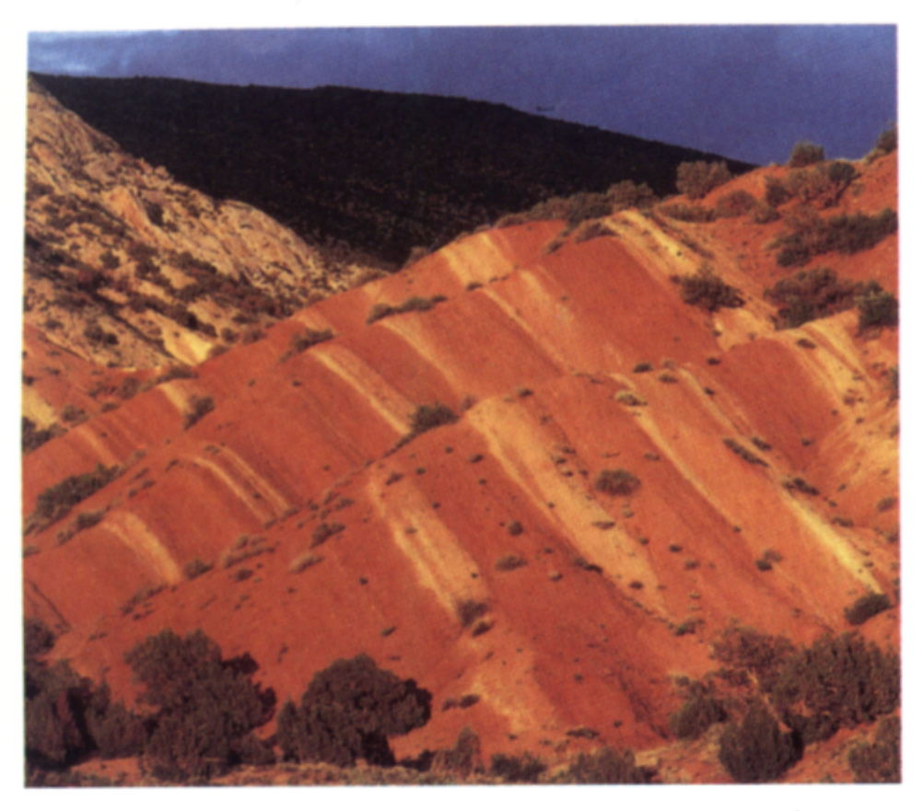
A
Tilting

Slide 40
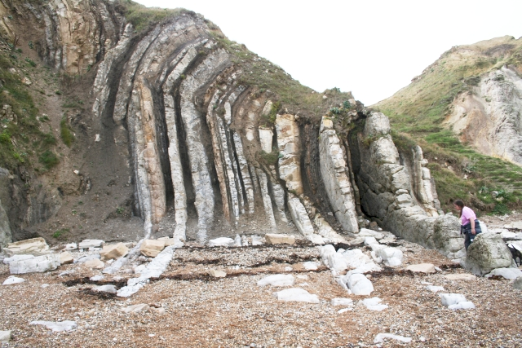
A
Tilting

Slide 41
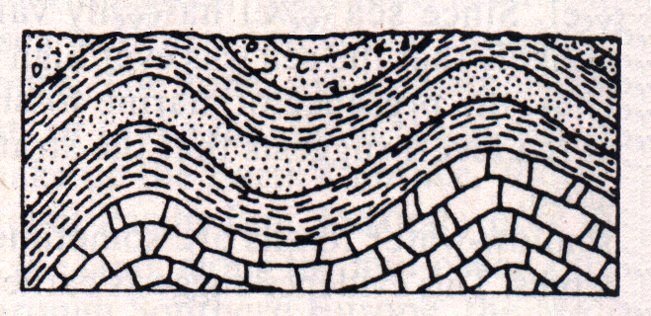
B
Folding
strata is bent as a result of extreme pressures

Slide 42
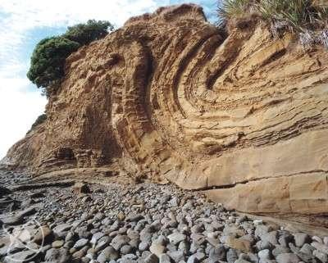
B
Folding

Slide 43
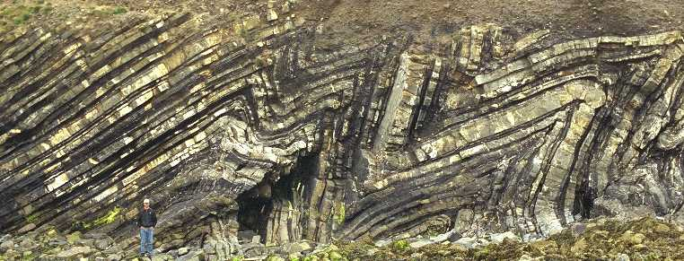
B
Folding

Slide 44
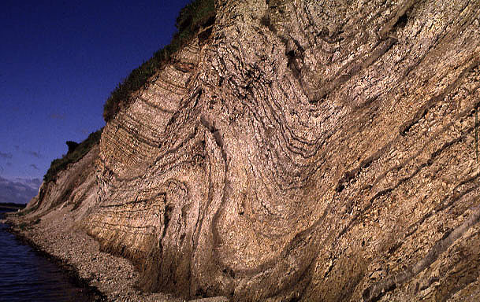
B
Folding

Slide 45
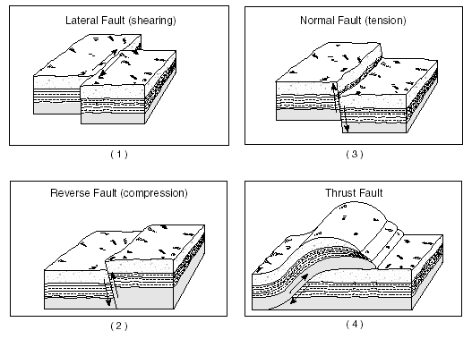
C
Thrust Faulting
a break in strata along which there is vertical (up-down) movement.

Slide 46
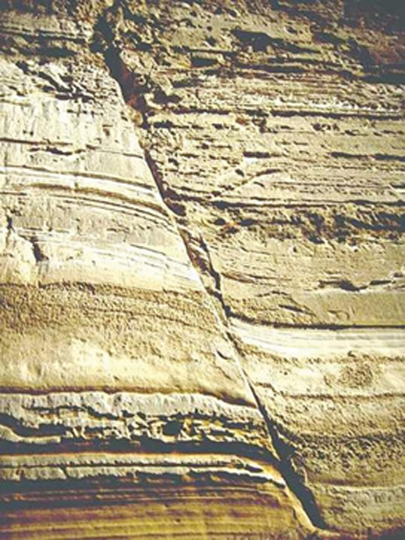
C

Slide 47
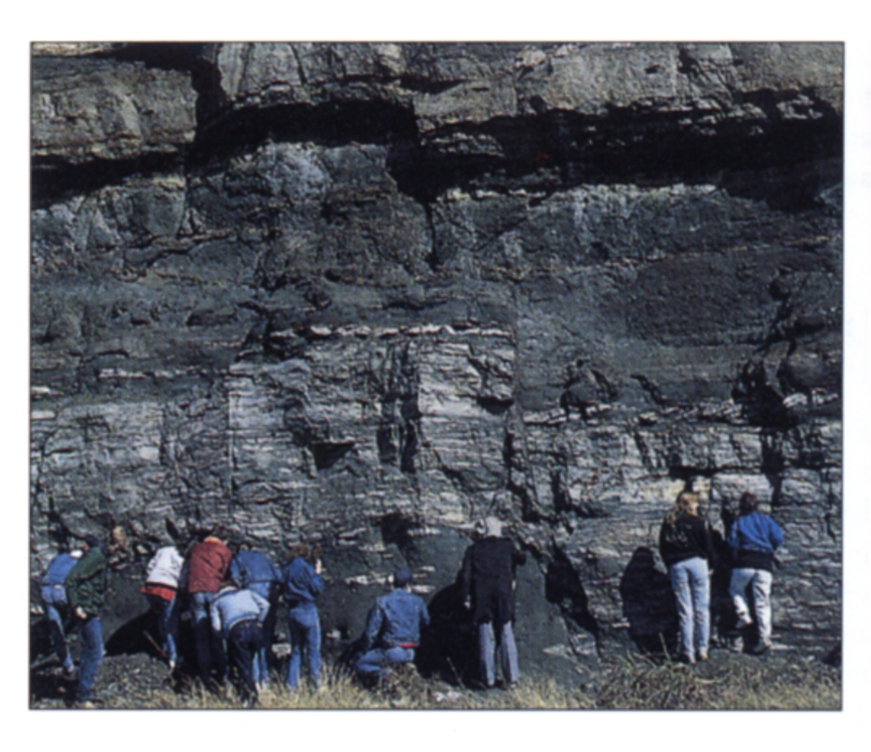
C

Slide 48
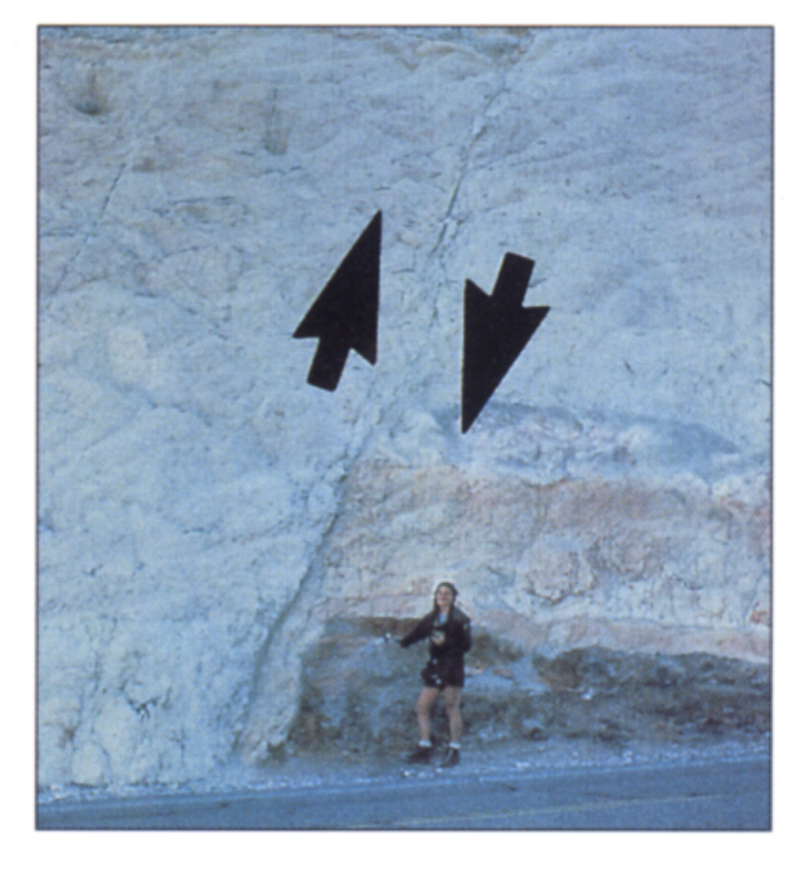
C

Slide 49
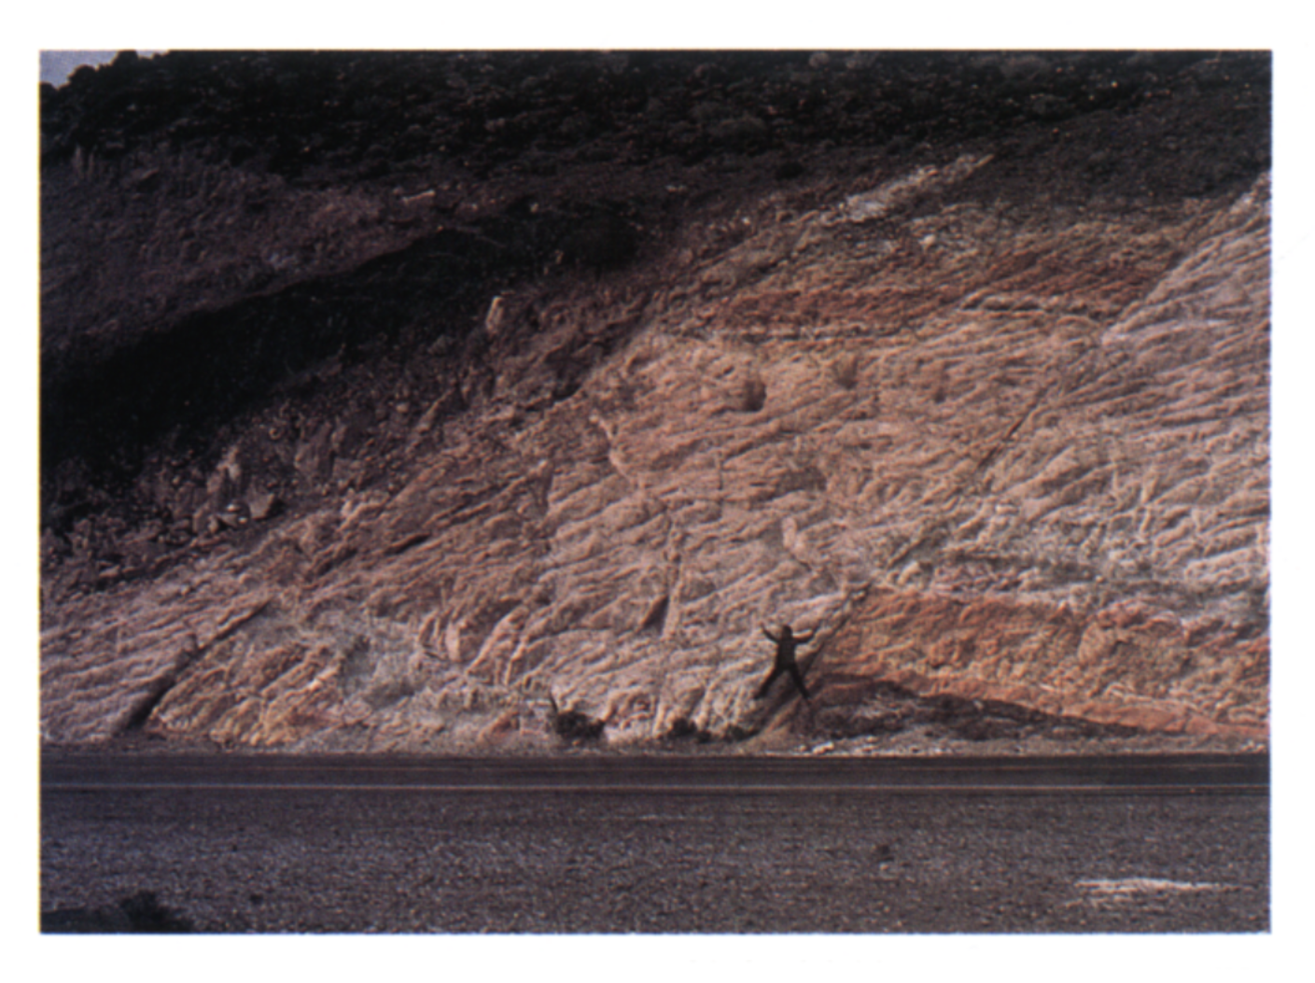
C

Slide 50
D
Transform Faulting
a break in strata along which there is horizontal (side by side) movement.

Slide 51
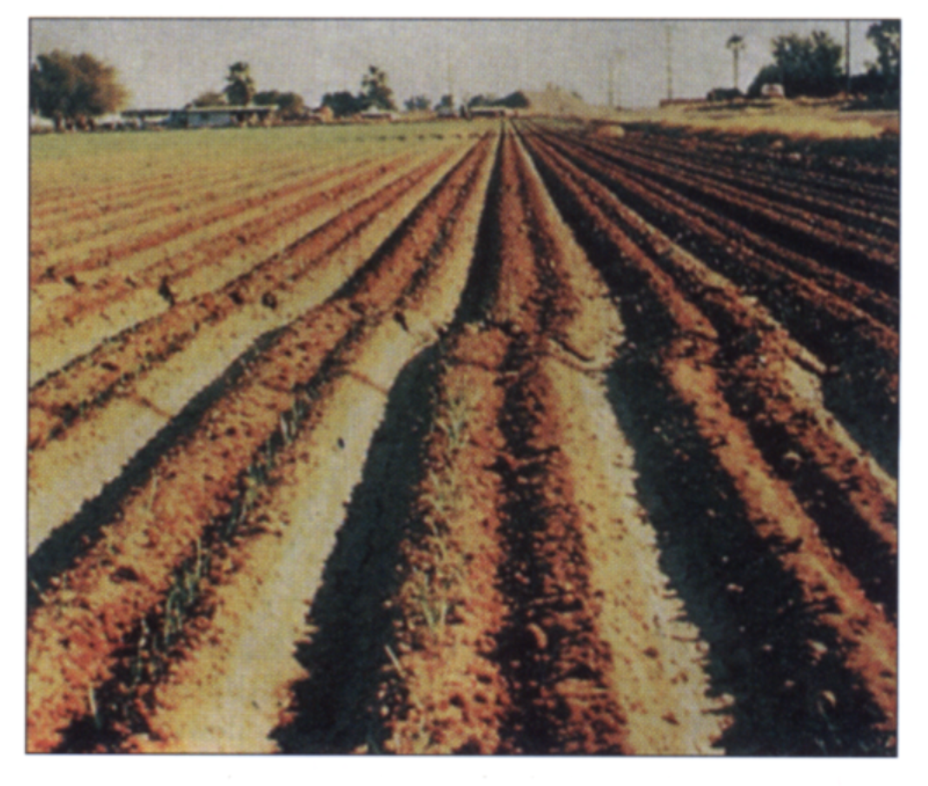
D
California

Slide 52
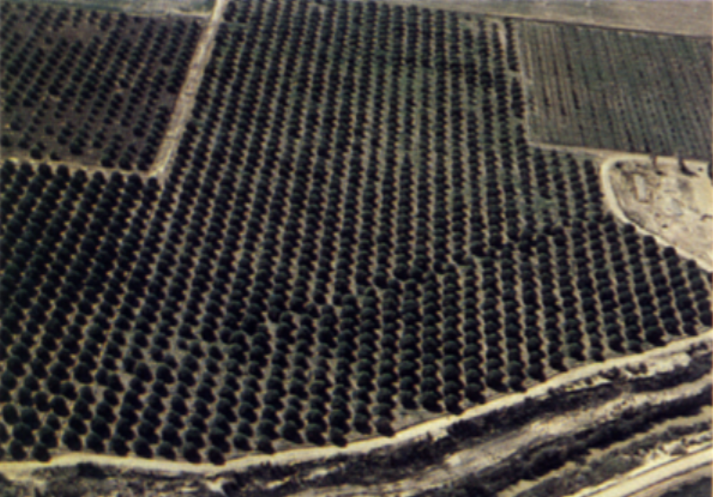
D
California - 1940

Slide 53

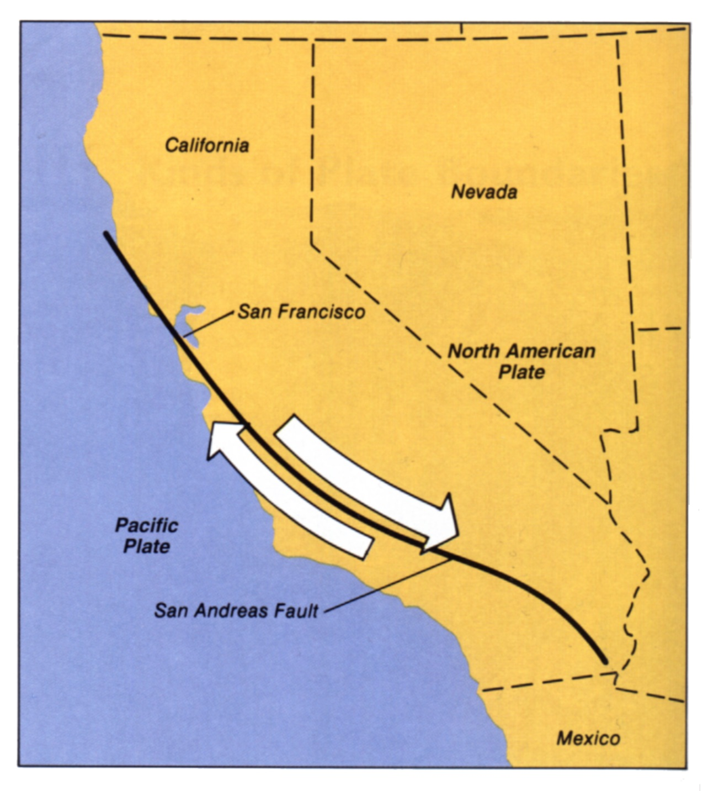
San
Andreas
Fault
California

Slide 54
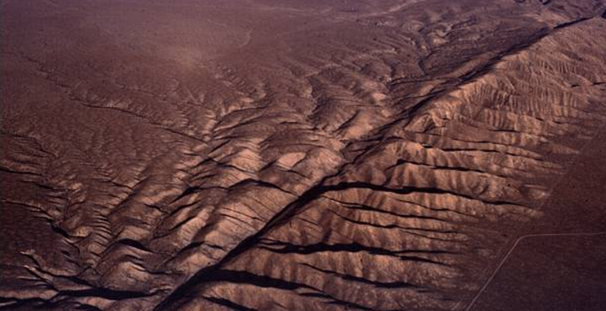
San Andreas Fault - California

Slide 55

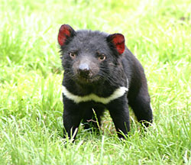
Open to page 248 …Its time for a …
Randomizer
DO NOW!

Slide 56
What is the temperature AND pressure at the boundary between the stiffer mantle and outer core?

Slide 57
Happy Monday after a much nicer weekend!
5/8
And the winners of the competition are ???
Plate Tectonics Quiz – Coming Soon!!

Slide 58


What evidence exists to support the Theory of Continental Drift?
Page 256
5/8
AIM:

Slide 59
Continental Drift
A theory which proposed that the continents have drifted apart over millions
of years of slow movement.

Slide 60
1
Continental “Puzzle-Like” Fit

Slide 61
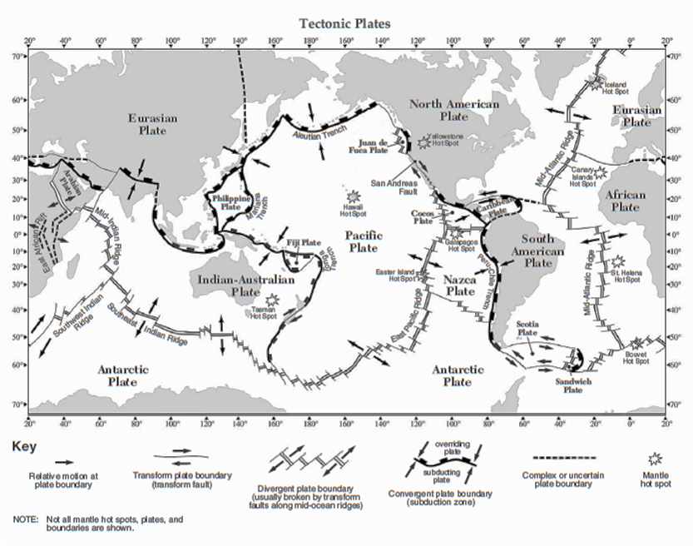

Slide 62
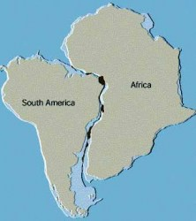

Slide 63
1
Continental “Puzzle-Like” Fit
Shorelines of North and South America fit with shorelines of Europe and Africa.

Slide 64
2
Fossil Evidence

Slide 65
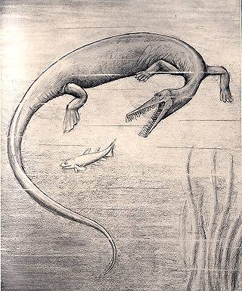

Slide 66
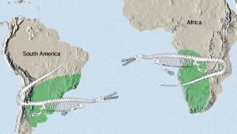

Slide 68
2
Fossil Evidence
Fossils of certain species found on different continents match up.

Slide 69
2
Fossil Evidence
Fossils of certain species found on different continents match up.
2. Fossils also indicate existence of different climates than the present continental positions.
Ex. Coral fossils or coal deposits from
former plant-life found in colder regions.

Slide 70
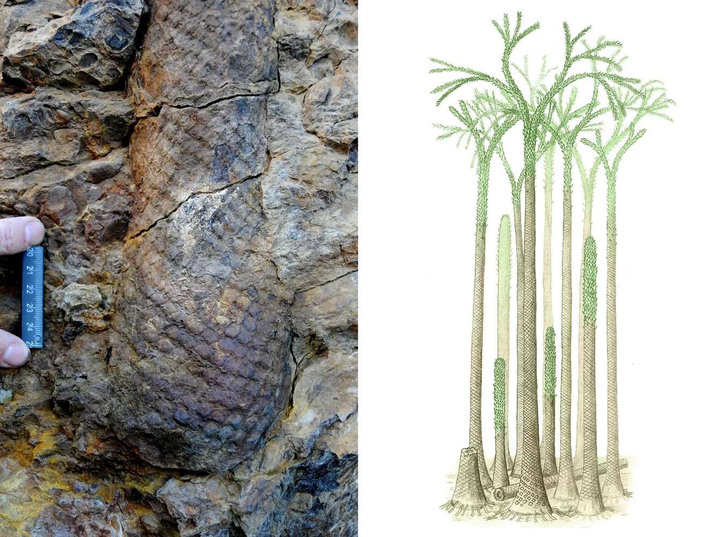

Slide 71

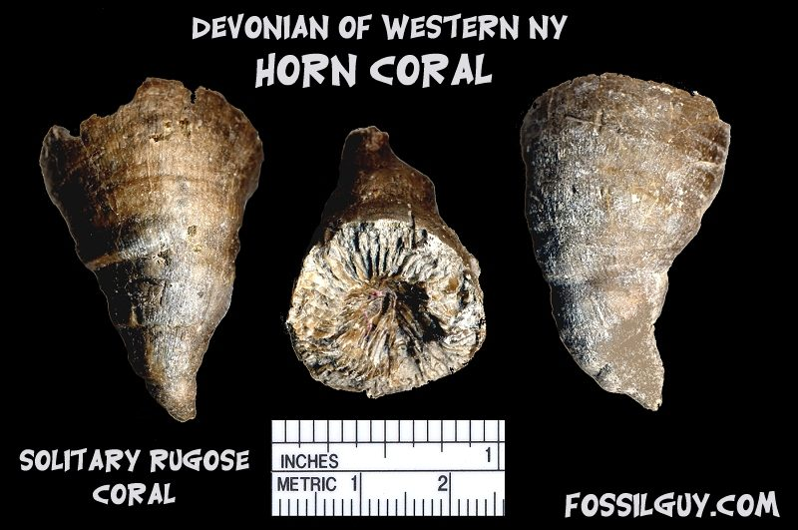

Slide 72
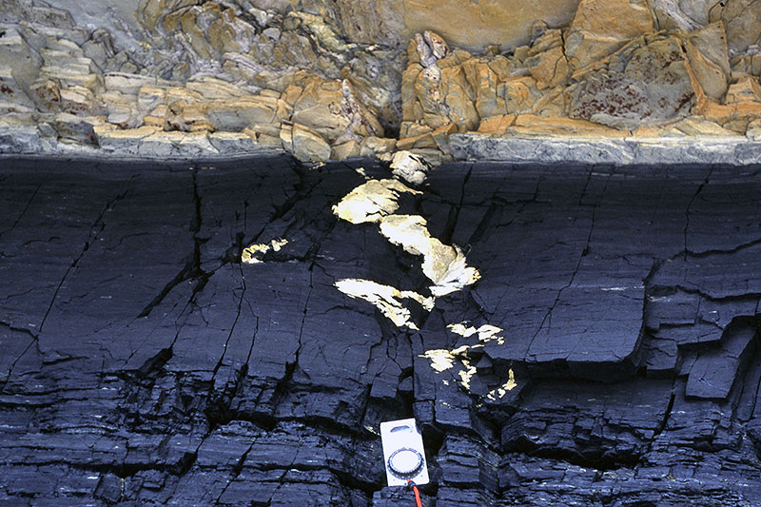
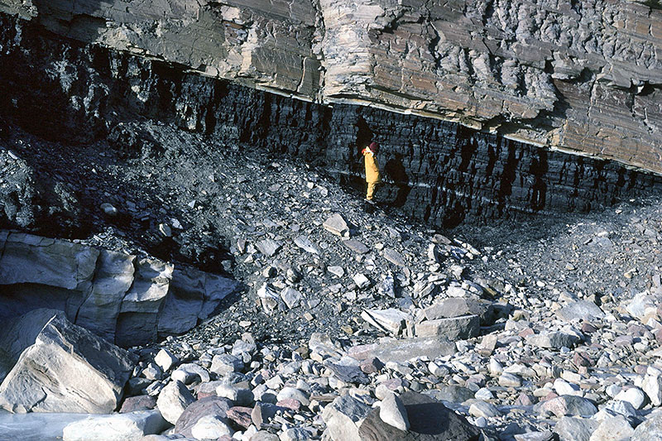

Slide 75
3
Rock Types
Continental rocks across the Atlantic Ocean match.

Slide 76
Next Up:
4/27
Open to ESRT page 5
We are going to color …
we need red, blue, green and orange

Slide 77
ESRT page 5

Slide 78
What evidence supports Sea-Floor Spreading?
page 257
5/9
Aim:

Slide 79
ESRT page 5

Slide 80
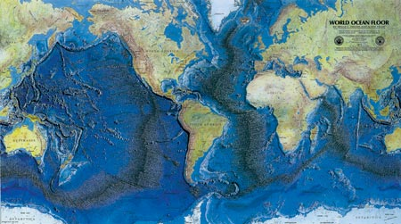

Slide 81
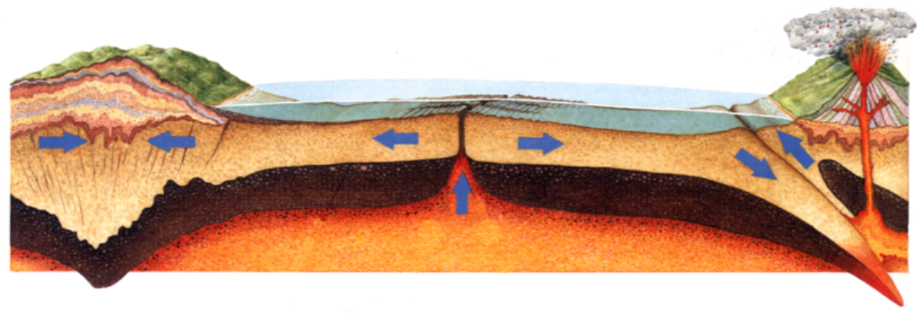
Sea-Floor Spreading

Slide 82
ESRT page 5

Slide 83
(we already learned on page 257)
D
Transform Faulting
a break in strata along which there is horizontal (side by side) movement.

Slide 84
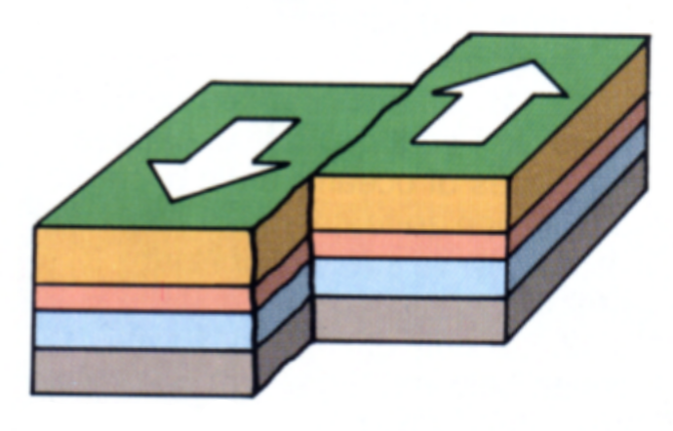
Transform Plate Boundary

Slide 85
ESRT page 5

Slide 86
Sea-Floor Spreading

Slide 87
1. Divergent Plate Boundary

Slide 88
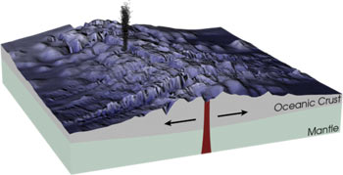
1. Divergent Plate Boundary

Slide 89
1
Divergent Boundary
plates move away from each other
mid-ocean ridges - submerged mountain and volcanic ranges

Slide 90
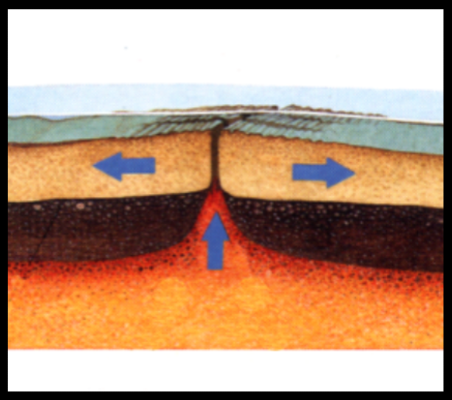

Slide 91
1
rising magma

Slide 92
ESRT page 10

Slide 93
1
Divergent Boundary
Convection currents in mantle cause hot material to move up to create new oceanic crust.
(youngest rocks found nearest to ridge)

Slide 94
ESRT page 10

Slide 95
1

Slide 96
ESRT page 5

Slide 97
1. Divergent Plate Boundary

Slide 98
2
Magnetic Reversals

Slide 99


Slide 100
2
Magnetic Reversals
spreading center
young rocks
older rocks
older rocks

Slide 101
2
Magnetic Reversals

Slide 102
2
Magnetic Reversals
provide evidence for sea-floor spreading
symmetrical pattern on opposite sides of ridge
cyclical shifting of Earth’s magnetic pole

Slide 103
2
Magnetic Reversals
provide evidence for sea-floor spreading
symmetrical pattern on opposite sides of ridge
cyclical shifting of Earth’s magnetic pole

Slide 105
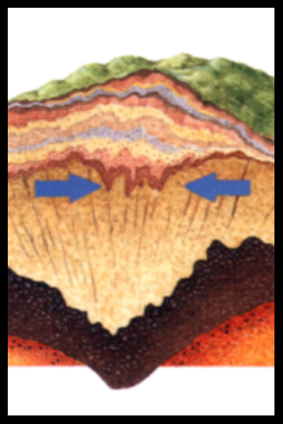
3

Slide 106
ESRT page 5

Slide 108
3
Convergent Boundary
Convergent Plate Boundary continent-to-continent collision
Lithosphere piles up thickening the crust forming mountains
Formation of the Himalayas
in India.

Slide 109
4. Convergent Plate Boundary

Slide 110
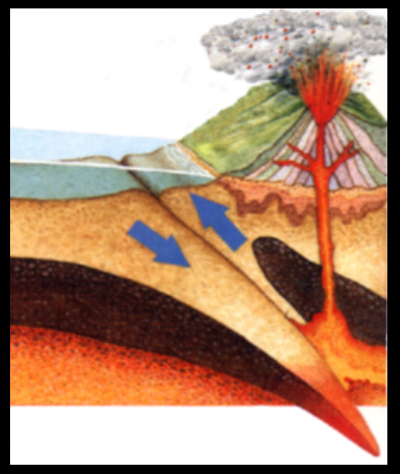
4

Slide 111
ESRT page 5

Slide 113
4
Convergent Boundary
Convergent Plate Boundary oceanic crust-to-continent collision
(or two oceanic crusts).
Subduction Zone (Trench)
Dense ocean crust is forced under continent, sinks into mantle, and melts.
Forms volcanoes or volcanic island arcs.

Slide 114
4
trench

Slide 115
ESRT page 5

Slide 118
What unified theory explains plate motions?
Page 260
4/28
Aim:

Slide 119
1. What is the Theory of Plate Tectonics?
Supercontinent “PANGAEA”
broke up as a result of “floating” plates moving because of convection currents in asthenosphere

Slide 120
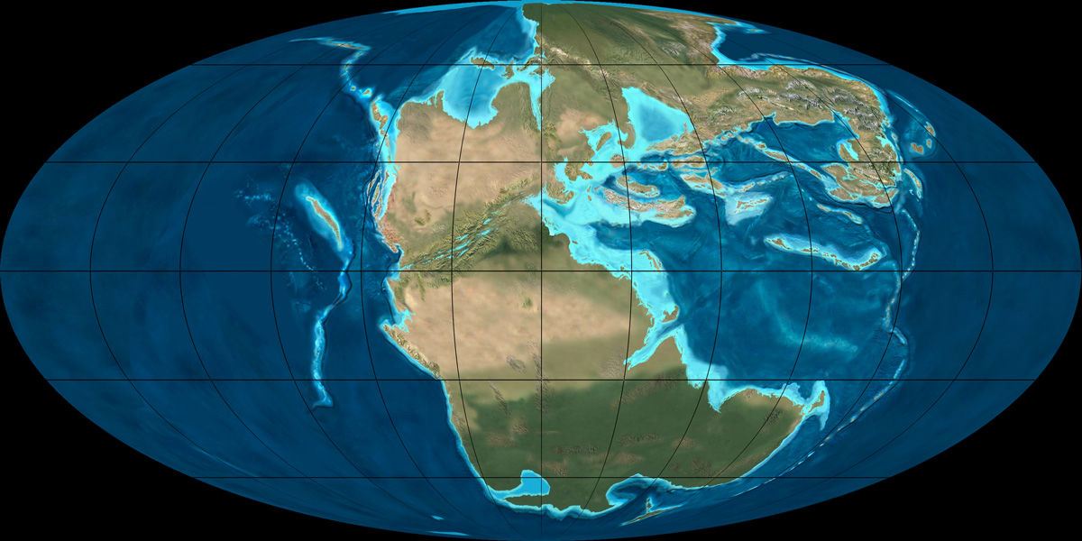
Pangaea or Pangea

Slide 122
2. What events occur at or near zones of crustal activity?
(plate boundaries)

Slide 123
2. What events occur at or near zones of crustal activity?
(plate boundaries)
a. earthquakes
b. volcanoes
c. mountain building events
d. tsunamis – ocean waves caused by
undersea earthquakes

Slide 125
ESRT page 5

Slide 126
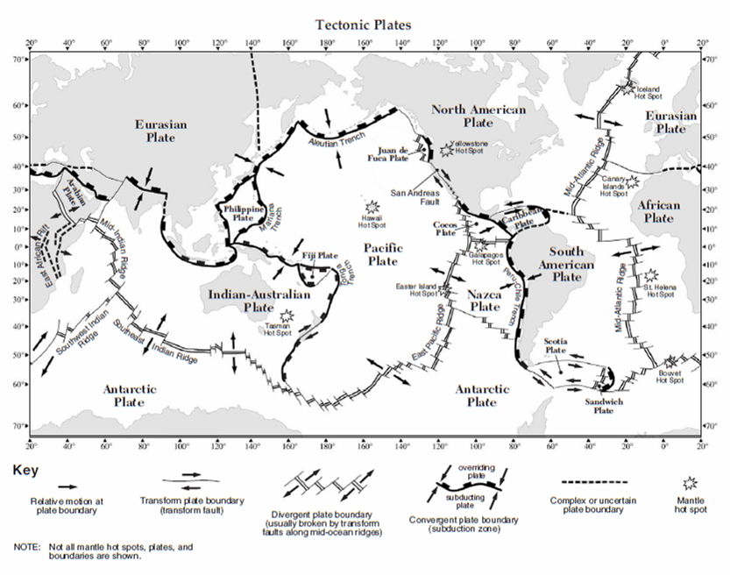
Ring of Fire

Slide 127
3. What occurs at mantle hot spots?
places in Earth’s surface
that magma rises up
from the mantle.

Slide 128
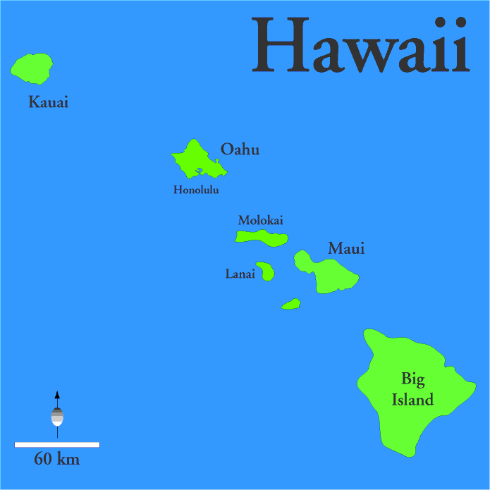

Slide 129
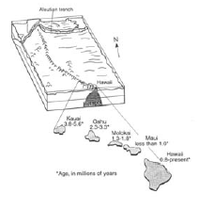

Slide 131
Pacific Ocean
HOT SPOT
Kauai
Oahu
The Big
Island
Maui
less than 1.0 mya
approx 4.7 mya
approx 2.3 mya
approx 1.2 mya

Slide 133
Pacific Ocean
Active Volcano while over
HOT SPOT
Kauai
Oahu
Maui
The Big
Island
older

Slide 134
What occurs at mantle hot spots?
As the crust moves over a hot spot, a chain of volcanic mountains form – the active volcano in the chain is the one directly over the hot spot.

Slide 135
Happy Friday!
(when we come back on Tuesday … it is MAY!)
4/29
We will start with a video about the 2011 Japan tsunami
Plate Tectonics Test – TUESDAY ?

Slide 136
Practice Time!!
Do your practice test on pages 261-264 to start our
review for Tuesday’s test

Slide 137
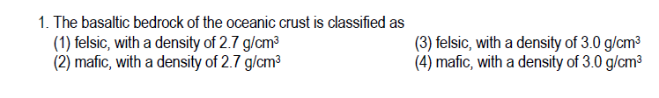
1.

Slide 138

2.

Slide 139


3.

Slide 140

4.

Slide 141

5.

Slide 142

6.

Slide 143

7.

Slide 144
8.

Slide 145

9.

Slide 146
10.

Slide 147
11.

Slide 148

12.

Slide 149
13.

Slide 150

14.

Slide 151


15.

Slide 152

16.

Slide 153
17.

Slide 154
18.

Slide 155

19.

Slide 156
20.

Slide 157

21.

Slide 158
22.

Slide 159

23.

Slide 160

24.

Slide 161
1.

Slide 162

25.

Slide 163
Happy May!! 5/3
One More Day of Review …
Please do as much as you can in the next 20 minutes and then we will go over for our Exam tomorrow

Slide 164
Today: 5/11
Read Intro to Planet Brave & Review Topic
Work on Planet Brave – use p277 and ESRT p5
Regroup near end of period to learn hotspots
Complete Planet Brave
Work on HW pages 279-282
HW:
1. Packet p279-282 & Planet Brave – THU
2. Dynamic Crust Exam – Fri 5/13
(includes Epicenter Lab Quiz)

Slide 165
1.

Slide 166
1.

Slide 167
2.

Slide 168
3.

Slide 169
4.

Slide 170

5.

Slide 171
6.

Slide 172
7.

Slide 173
8.

Slide 174
9.

Slide 175
10.

Slide 176
11.

Slide 177

12.

Slide 178
13-14.

Slide 179
15.

Slide 180
16.

Slide 181
17.

Slide 182
18.

Slide 183

19.

Slide 184
20.

Slide 185
23.

Slide 186

24.

Slide 187

Planet Brave!
Rosenblatt
Sambursky

Slide 189
Today: 5/11
Finish learning about hotspots and
do some topic review
Work on HW pages 279-282
HW:
Packet p279-282 – THU
2. Epicenter Lab Quiz – THU
3. Dynamic Crust Exam – Fri 5/13

Slide 195

R
S
J
K

Slide 197



Slide 199

ESRT page 11

Slide 200
Today: 5/12
1. Hand in Planet Brave Lab
2. Open to page 279
and page 5 in ESRT - NOW!!!!!!
HW:
Dynamic Crust Exam – Fri 5/13
(includes Finding an Epicenter like you did in lab)

Slide 201
Complete Planet Brave Lab and do
Dynamic Crust
Review
Pages 279-282

Slide 203
R
S
Melillo MOR
J
J
Tom’s Trench
K
K

Slide 204
Mid-Ocean Ridge
g
oceanic
crust
Melillo MOR
oceanic
crust
Dangeva
Massaro
mantle

Slide 205
1
rift valley
rising magma

Slide 206
Subduction Zone
oceanic
crust
Tom’s Trench
Magloire Mtns
Massaro
Naughton
continental
crust
mantle

Slide 207
4
trench

Slide 208
R
S
Rizzo Ridge
J
J
Tumminello Trench
K
K

Slide 209
1
rift valley
rising magma

Slide 210
4
trench

